Slide 1


Basic Security Officer Training
Emergency Response

Slide 2

9/11/01

Slide 3

TRAINING OBJECTIVES
Differentiate between the 2 major categories of emergencies.
Identify and describe at least 10 examples of emergencies and their critical nature.
Outline the procedures that are needed in an emergency plan.
Gather and process essential information and protect the immediate area.

Slide 4

TRAINING OBJECTIVES
Recognize the appropriate procedural response to a workplace violence and bomb threat incident and to severe weather at your worksite.
Differentiate between safety terminology and how to use the terms in your workplace.
Distinguish between the different types of alarm systems and how they assist with identifying emergency incidents.

Slide 5
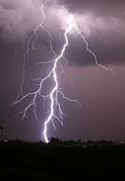
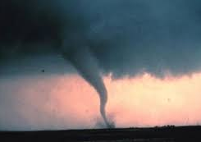
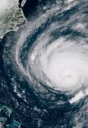
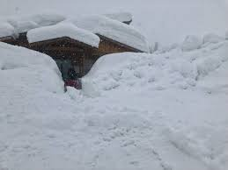
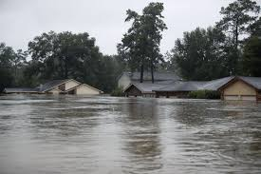
NATURAL EMERGENCIES

Slide 6


HEART ATTACKS

Slide 7



OVERDOSE
Revert to your training
Report the person’s condition to Emergency Responders
Locate and secure any evidence

Slide 8
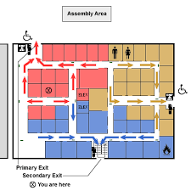
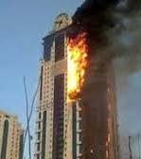
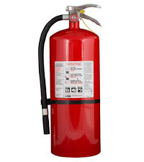
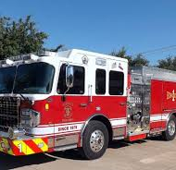
FIRES

Slide 9


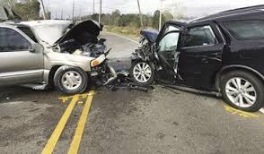
ACCIDENTS

Slide 10
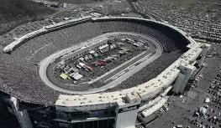
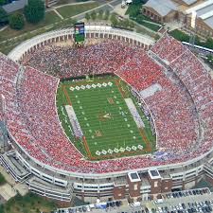
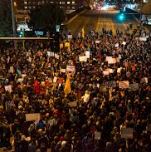
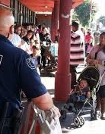
PUBLIC EVENTS and DEMONSTRATIONS

Slide 11
Labor Disputes
We want our benefits back!!
Pay us or lose us!!

Slide 12
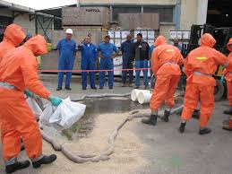
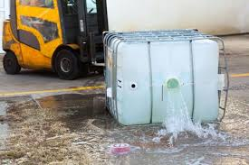
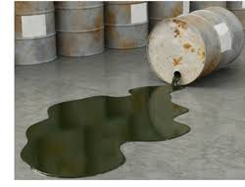
CHEMICAL SPILLS

Slide 13
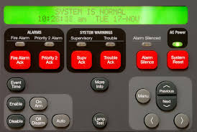
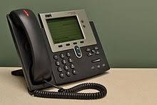

POWER FAILURE
Alarm Systems
Television Monitors
Telephones
Lighting

Slide 14
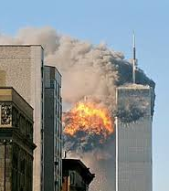
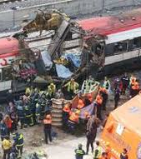
TERRORISM

Slide 15
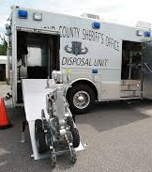
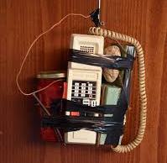

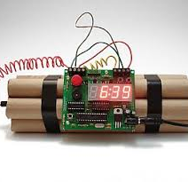
BOMB THREATS

Slide 16
EMERGENCY PLANS
WHO TO NOTIFY? (supervisor, client, etc.)
RESPONSIBILITIES (First Aid, etc.)
LOCATION OF EMERGENCY EQUIPMENT (fire extinguisher, etc.
COMMUNICATION (radio, telephone, ect.)
LIMIT ACCESS (only authorized personnel)
CHECKLIST (who, what, where, etc.)
DRAWINGS/MAPS
EVACUATION

Slide 17
ESSENTIAL EMERGENCY INFORMATION
SOURCE OF INFORMATION
NATURE OF THE EMERGENCY
LOCATION
TIME
INJURIES
DAMAGES
ACTIONS
PERSONS NOTIFIED
WITNESSES

Slide 18
IDENTIFY WITNESSES
Who saw the incident?
Who was present before the incident occurred?
Who was present immediately after the event?
Who can identify the individual(s) involved?
Who is knowledgeable of the background leading to the incident?

Slide 19
PROTECTING THE SCENE
Control Access
close/lock access to the area
use rope/tape to isolate area
Protect Evidence
fingerprints or items that could contain fingerprints
tire tracks, etc.
body fluids
out of place items
weapons

Slide 20

WORKPLACE VIOLENCE
In 2017 a total of 18,400 injuries and 458 deaths were reported as a result of workplace violence.*

Slide 21

BEHAVIORAL CUES
Sudden/persistent complaining about being treated unfairly
Blaming others for personal problem
Deterioration of job performance
Statements wishing bad things to happen
Paranoid
Absenteeism
Sexually harassing/obsessing about a co-worker
Talking to oneself

Slide 22
BEHAVIORAL CUES, continued
Family/Financial problems
History of violence
Previous threats
Carrying weapons (Concealed or open)
Sudden mood swings/depression
Refusal to comply with rules or instructions
Inability to control emotions

Slide 23
COMMON OFFENDERS
The spouse or partner of an employee
Rejected suitors/co-workers
Ex-employees
Persons committing an Armed Robbery
Gang members

Slide 24

RESPONSE TO WORKPLACE VIOLENCE
If you observe suspicious behavior, notify your supervisor and other guards.
Wait for help
Use calm/soothing statements
Contain the individual
Try to get individual to leave
Be aware of company/client policies.

Slide 25
BOMB THREAT PROCEDURES
Do not use
Do not use radio or cellular telephone
Notify
Notify client and supervisor
Gather
Gather as much information as possible
Empathize
Empathize with the caller
Record
Record information
Identify
Identify phone numbers (caller and incoming line)

Slide 26
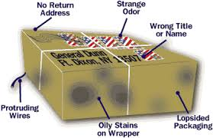
Search Procedures
Where to look
How to search (Top floor down, etc.)
What is unusual or suspicious
Don’t touch it, report only

Slide 27
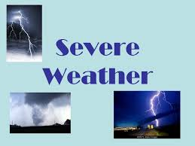
SEVERE WEATHER
WATCH-Conditions are favorable for severe weather
WARNING-Severe weather is in the area and likely

Slide 28



SAFETY IN THE WORKPLACE
Material Safety Data Sheets (MSDS or SDS)
HazCom
Burn Permit
Confined Space Permit
Lock Out-Tag Out (LOTO)
Blood Born Pathogen

Slide 29
ALARM SYSTEMS
Silent Alarms
Warning Alarms
Combination Alarms

Slide 30






ALARM SYSTEMS
Burglar or Intrusion
Fire
Hold up or Panic
Closed Circuit cameras
Card or Code Access
Detection Monitors

Slide 31
TRAINING OBJECTIVES
Differentiate between the 2 major categories of emergencies.
Identify and describe at least 10 examples of emergencies and their critical nature.
Outline the procedures that are needed in an emergency plan.
Gather and process essential information and protect the immediate area.

Slide 32
TRAINING OBJECTIVES
Recognize the appropriate procedural response to a workplace violence and bomb threat incident and to severe weather at your worksite.
Differentiate between safety terminology and how to use the terms in your workplace.
Distinguish between the different types of alarm systems and how they assist with identifying emergency incidents.

Slide 33

Questions

Slide 34
Answer these questions:
Do you know the correct response procedure to an emergency procedure?
Can you remain calm and implement the procedure?
Will you?

