Slide 1
Juvenile Community Programs
RtA Program Expansion Highlights
Juvenile Jurisdiction Advisory Committee
July 16, 2021

Slide 2
Lessons Learned During a Pandemic
State government processes CAN move quickly!
Our innate “warrior” attributes CAN prove to be useful!
Partnership REALLY DOES mean PARTNERSHIP!
Notes:
Amendments CAN move quickly when the mission needs to urgently be supported. Hazard pay increases to all residential providers via contract amendments to compensate direct care staff.
Learning how to outmaneuver a virus, learning how to cohort housing units with an exposure, quarantining individual youth based on CDC guidelines ,being vigilant with PCP, hand washing, and social distancing
Learning how to Make it Work! Shuttling youth to local health departments, using nursing staff to administer covid tests, carrying precious cargo (Covid test kits) to state labs for quick COVID test results and then acting on knowledge of exposures, isolating, moving, releasing direct care staff to go home to wait out COVID exposures, or worse, to even battle the virus.

Slide 3
Juvenile Community Highlights
JCPC Program Expansion
Restorative Justice expansion initiative
State Level Residential and Community-based Contracts
Capacity expansion via Contract Amendments
New Contracts
Regionalized Programming
Development of unique Partnerships

Slide 4
Roadmap to RtA System Implementation
Use of evidence-based system reforms that are tried and true ¹
Expanding use of diversion
Making probation and aftercare approaches more effective
Addressing MH needs
Reduce use of pretrial detention
Reduce reliance on secure facilities, focusing on community-based approaches
Keep youth safe via PREA(Prison Rape Elimination Act) compliance
Improve JJ’s management of resources, serve youth more effectively
Notes:
Remind the JJAC that NC began its movement toward a developmentally appropriate juvenile justice system employing these principles before RtA legislation, however the work continues to evolve and requires continuing improvement and adaptation of more effective policies based on reevaluation of our work.
Use of diversion- NC has been strong in its statewide efforts to support early intervention. Note: administrative directive to require access to early intervention restorative justice practices in all counties
Making Probation and aftercare effective: Adopting the use of the YASI and focusing on youth needs and service matching.R2R reentry initiative with promising re-entry results.
Addressing MH needs- We know that 1 in 5 young people between 13 and 18 will face a MH challenge at some point during adolescence. 86% of our YDC youth carry at least 1 MH diagnosis, with the most frequently categories of diagnosis being in the class of disruptive, impulse control and conduct disorders. The second being trauma or stress-related disorders being found in about half of the YDC population. This category is 2 times more likely with our females than males, with 100% of our female population in YDC and over half in our Community Programs residential programs. The section continues to engage in contracted services that provides trauma informed service delivery and continues to educate providers on trauma informed care.
Reduce use of pre-trial detention. Research shows that detention can have negative effects: Youth who are detained are more likely to reoffend than youth who are not detained; Physical and MH conditions worsen, youth face challenges reconnecting to school, getting a job or staying employed. Comm. Programs is developing targeted re-entry programming to assist with detention and YDC populations. Also, the department has been utilizing a detention screening tool with efforts afoot to validate the tool with the assistance of RTI via grant funding. Additionally, community programs continues to use its crisis and assessment centers to assist with younger youth. Also, Better utilization of Alternatives to Detention policy driven actions to avoid detention stays. The section currently has an OJJDP grant to pilot a pretrial release model and is currently exploring this option with 8 counties surrounding Wake.
Reduce reliance on secure facilities: pushing to place needed interventions within the community or regionally based, to provide services closer to home.
Improve management of resources: Partnering with Office of State Budget and Management to participate in the Results First Initiative, performing a benefit cost analysis of all programming to inform and guide policy decision making and fiscal management.
We are grateful to the JJAC in its support to allow us to continue to move along and remain true to best practices with our reform efforts.

Slide 5
JCPC RtA Expansion Strategies
JCPC Tiered Planning
Executed continuum building plans in preparation of RtA expansion funding- JCPCs advance planning to execute local Program Agreements once budget allowed
Executed administrative directive requiring access to restorative justice model programs in all counties
Benefits of diversion/restorative justice programming ²
Reduces trauma associated with JJ involvement and helps build health relational and community support-gives opportunity to take responsibility
Rehabilitative rather than punitive leading to reduced recidivism
Cost savings vs use of JJ system
Establish multi-county/regional-based programming options
Edited general statute to allow multi-county and multi-district programming options (HB 593)
Enhanced NCALLIES functionality to support multi-county/district programming
Ex: Kids at Work, vocational program with 17 -county access
Notes:
Your support of the section’s RtA expansion plan enabled the section to prepare local communities to address this population’s programming needs. JCPC planning efforts began on the heels of passage of RtA legislation in July of 2017. Since JCPCs are forward thinking bodies and their work during a fiscal year is in preparation of for the next fiscal year, anticipatory pre-planning had to occur so that quick movement could occur when and if a JCPC fund expansion would occur. In September 2019, this occurred, and Counties were poised to execute their planning strategies and continuum building through the guidance of area consultants. Administrative memos instructed JCPCs to work toward access to restorative justice models that could assist with keeping the “donut hole” juveniles, those caught between the passing of RtA legislation and an effective implementation date, to keep these youth out of the criminal justice system.
Benefits of restorative justice: Rehabilitative vs. punitive, opportunity to take responsibility
Established greater use of multicounty/ regional based programming options which required additional edits to the legislation and enhanced functionality of NCALLIES.
Example Kid’s At Work to 17 counties coverage via multicounty Program agreements.

Slide 6
Increase in JCPC Vocational Programs 16 and 17 Yr Old Admissions
Notes:
Note: Tyranny in small numbers.
Marked improvement in vocational programming to address the target population and JCPC funded programming moved from 7 to 12 to 23 funded programs. Kids at Work has been able to expand their culinary programming model to 17 counties in the western and piedmont areas. Juvenile over the age of 16 in these programs make up 65% of all admissions.

Slide 7
Increase in Community Programs 16 and 17 Yr Old Diverted Juvenile Admissions
Notes:
Again, based on legal status at admissions to Community Programs, 16 and 17 year old of diverted juvenile admissions have more than doubled for this population. Just to show this by way of investigation other Legal Statuses at admission,…the next graph shows of juvenile jurisdiction policy impacts with RtA legislation.

Slide 8
RtA Jurisdiction Policy Impacts Decrease in Deferred Prosecution Admissions for 16 and 17 Year Olds
--77%
Notes:
RtA legislation offered the opportunity to our 16 and 17 year old first-time offenders to benefit from remaining in the JJ system, who previously because of their age, would have landed in adult criminal court jurisdiction. Often use of a deferred prosecutions and referral to Teen Courts would occur for this population. Once there was completion of the diversion programs, the charges were most often dropped. Diversion programs provided an avenue for youth to be accountable, to take responsibility for his/ her actions, and even offer restoration to victims. Court deferred prosecution admissions to JCPC programs have impacted by RtA jurisdictional policy changes whereby now most first time 16 and 17 yo offenders remain in juvenile court jurisdiction and are diverted at intake, thus no longer landing in adult court jurisdiction.
One of our strategies included increasing access to diversion programming, pushing for access Teen Court and other restorative justice models prior to full implementation in an effort to provide consistent access to such program models. The section imposed an administrative directive to county JCPCs, requiring planning for use of RtA expansion dollars toward restorative justice programming model accessibility.
There is some work afoot in the section via collaborations with Jonathan David, Brunswick county DA, and Sam Davis with Brunswick County Teen Court to pilot a Brunswick county Teen Traffic Court whereby diversion may be used for identified traffic offenses that have been identified by the DA . ( Judge Ashley Gore and Judge McGee are assisting with this project.The defendant claims responsibility, is referred by the DA and if the program is completed, charges are dismissed . The benefits to youth and family include no pts on drivers license, no court costs or fines, no attorney fees, no lost time from school or work to attend court, no district court trial or hearing.

Slide 9
Teen Courts
60 Counties (Pre-RtA)
FY2018-2019
Ashe
Alleghany
Surry
Stokes
Warren
Northampton
Gates
Rockingham
Caswell
Person
Camden
Vance
Hertford
Pasquotank
Currituck
Watauga
Wilkes
Granville
Halifax
Perquimans
Avery
Yadkin
Forsyth
Guilford
Franklin
Bertie
Chowan
Mitchell
Alamance
Orange
Durham
Nash
Madison
Yancey
Caldwell
Alexander
Davie
Edgecombe
Iredell
Davidson
Wake
Martin
Washington
Tyrrell
Mcdowell
Burke
Catawba
Randolph
Chatham
Wilson
Dare
Buncombe
Rowan
Pitt
Swain
Haywood
Lincoln
Johnston
Greene
Hyde
Rutherford
Cabarrus
Lee
Harnett
Wayne
Graham
Henderson
Polk
Cleveland
Gaston
Stanly
Montgomery
Moore
Jackson
Transylvania
Mecklenburg
Lenoir
Craven
Cherokee
Macon
Pamlico
Clay
Union
Anson
Richmond
Hoke
Cumberland
Sampson
Jones
Duplin
Scotland
Onslow
Robeson
Bladen
Pender
Columbus
New Hanover
Brunswick
Funded by other sources
Teen Courts Funded by JCPC
Notes:
Pre RtA implementation—discussion and planning toward restorative justice model expansion, pushing for accessibility to the 16 and 17 year old population to provide diversionary resources to District Attorneys and judges prior to RtA implementation. Sixty (60) counties offered teen courts in FY18-19. Training was offered by the section to support restorative justice models such as peer circles, sentencing circles, truancy courts, and victim offender mediation models. Note: 56% of referrals to Teen Courts for 16 and 17yos in 2014-15 came from District Court judges and SROs

Slide 10
Teen Courts/ Restorative Justice Expansion
96 Counties
FY2019-20 (1st Year RtA Expansion)
Ashe
Alleghany
Surry
Stokes
Warren
Northampton
Gates
Rockingham
Caswell
Person
Camden
Vance
Hertford
Pasquotank
Currituck
Watauga
Wilkes
Granville
Halifax
Perquimans
Avery
Yadkin
Forsyth
Guilford
Franklin
Bertie
Chowan
Mitchell
Alamance
Orange
Durham
Nash
Madison
Yancey
Caldwell
Alexander
Davie
Edgecombe
Iredell
Davidson
Wake
Martin
Washington
Tyrrell
Mcdowell
Burke
Catawba
Randolph
Chatham
Wilson
Dare
Buncombe
Rowan
Pitt
Swain
Haywood
Lincoln
Johnston
Greene
Hyde
Rutherford
Cabarrus
Lee
Harnett
Wayne
Graham
Henderson
Polk
Cleveland
Gaston
Stanly
Montgomery
Moore
Jackson
Transylvania
Mecklenburg
Lenoir
Craven
Cherokee
Macon
Pamlico
Clay
Union
Anson
Richmond
Hoke
Cumberland
Sampson
Jones
Duplin
Scotland
Onslow
Robeson
Bladen
Pender
Columbus
New Hanover
Brunswick
Funded by other sources
Notes:
Central and East: Mediation Teen Court and do a Teen Council and Sentencing Circles Teen Court through the school system. The 6th District combining their resources and having a Teen Court program for the entire district (Judge Branch is working on it). West: Sentencing Circles (Avery, Caldwell, Burke, Madison, Mitchell, Catawba) Mixture of Teen Court and Sentencing Circles (Cherokee and Clay) Teen Court (Graham, Haywood, Jackson)
Piedmont: Alleghany, Ashe (Youth Tribunals) Stokes: Impact Circles

Slide 11
Teen Courts/ Restorative Justice Expansion
99 Counties
FY2020-21 (2nd Year RtA Expansion)
Ashe
Alleghany
Surry
Stokes
Warren
Northampton
Gates
Rockingham
Caswell
Person
Camden
Vance
Hertford
Pasquotank
Currituck
Watauga
Wilkes
Granville
Halifax
Perquimans
Avery
Yadkin
Forsyth
Guilford
Franklin
Bertie
Chowan
Mitchell
Alamance
Orange
Durham
Nash
Madison
Yancey
Caldwell
Alexander
Davie
Edgecombe
Iredell
Davidson
Wake
Martin
Washington
Tyrrell
Mcdowell
Burke
Catawba
Randolph
Chatham
Wilson
Dare
Buncombe
Rowan
Pitt
Swain
Haywood
Lincoln
Johnston
Greene
Hyde
Rutherford
Cabarrus
Lee
Harnett
Wayne
Graham
Henderson
Polk
Cleveland
Gaston
Stanly
Montgomery
Moore
Jackson
Transylvania
Mecklenburg
Lenoir
Craven
Cherokee
Macon
Pamlico
Clay
Union
Anson
Richmond
Hoke
Cumberland
Sampson
Jones
Duplin
Scotland
Onslow
Robeson
Bladen
Pender
Columbus
New Hanover
Brunswick
Funded by other sources
Teen Court/ Restorative Justice Program Expansion

Slide 12
Overall Increase in Community Programs 16 and 17 Yr Old Court-Involved Juvenile Admissions
Notes:
Drilling down into legal status at time of admission, there is an overall increase in admissions for 16 and 17 year olds across all programming within the continuum of services offered by CP

Slide 13
RtA State-Level Contracts and Residential Expansion

Slide 14
RtA State Contract Expansion Strategies
Residential Programming Expansion
RtA data supported a projected need of 66 Beds
Expansion of Community-based FFT Contract
Access in 100 counties
Expansion of Crisis and Assessment Center for eastern area access
Telepresence enhancements at all residential sites

Slide 15
RtA Admissions Intensive Intervention Programs (Regional, Community-Based, and State Contracted Residential)
Notes:
All Non-JCPC Funded Programs admissions
We believe that we have been able to grow access and match needed services to increase 16 and 17 yo admissions even during a pandemic!

Slide 16
RtA RESIDENTIAL EXPANSION
217
151 Beds
Exploring additional residential sites and models
Development in Guilford/Forsyth County area
Independent Living Models
Notes:
IN TOTAL A 56 Bed Capacity Increase since RtA implementation and 10 shy from our goal
By July 1, 2020 (last year) -16 Bed increase
+ TOTAL OF 8 TRANSITIONAL LIVING BEDS (UNION 2 AND FORSYTH 6)
+ TOTAL OF 8 MPGH BEDS
Total of 167 beds by July 1 2020
By July 1, 2021 we had accomplished an increase of +40 SHORT-TERM RESIDENTIAL BEDS bringing the total to 207
We continue to seek out a site in the piedmont for one more MPGH model
.

Slide 17
RtA Crisis and Assessment Center Expansion
Renovations in progress at Dobbs Campus (former Green Cottage) slated to be completed in spring of 2022.
Eastern Area Crisis and Assessment Center will allow expansion of up to 12 additional beds.
Notes:
Contract amendments during the pandemic allowed the section to increase Crisis and Assessment bed capacity a total of 6 beds: from 25 beds and 4 secure to 31 beds and 4 secure. Renovations Green Cottage on Dobbs campus in Lenoir, NC is slated to be completed in the spring of 2022. This will serve the eastern area of NC

Slide 18
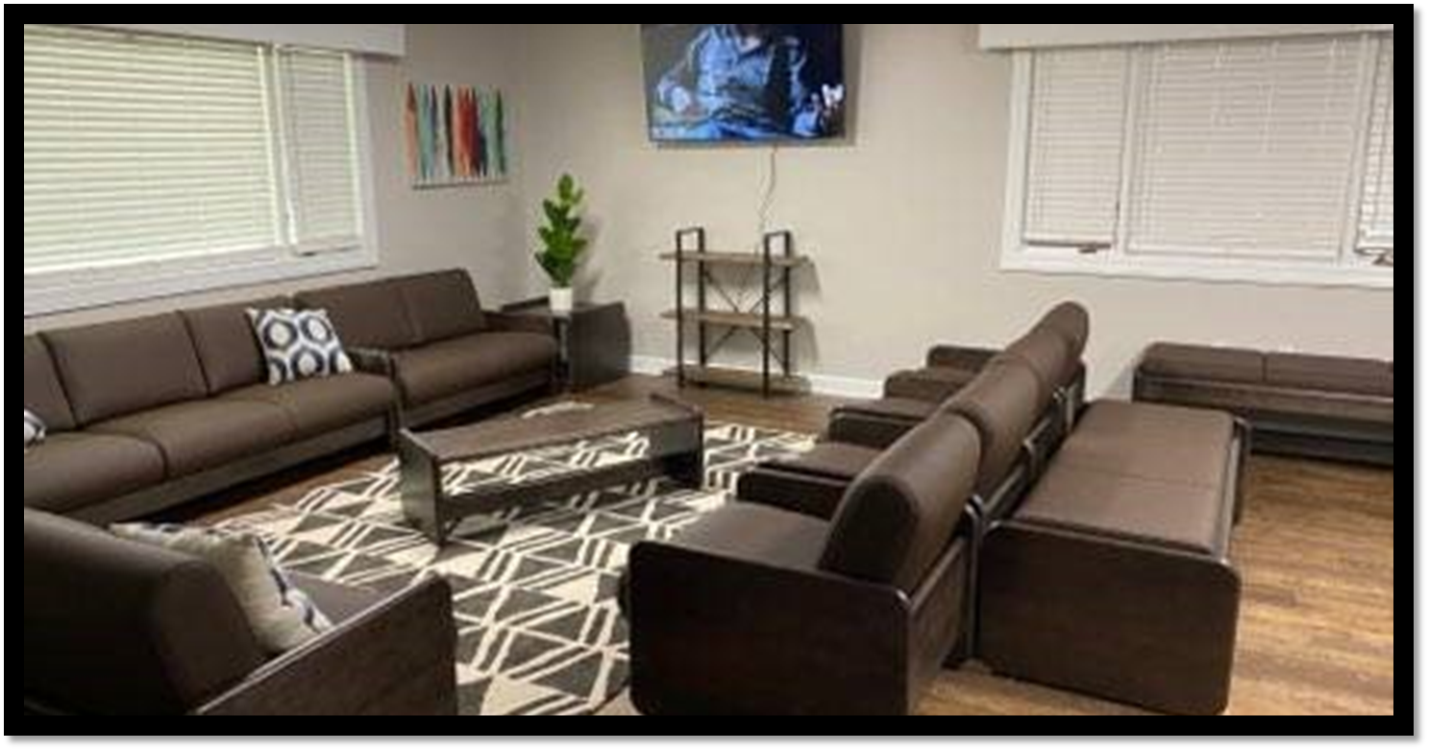
Union County MPGH
Established in partnership with Union County Government (DSS)
Blended Model-MPGH/Transitional Living Model
10 Beds
2 Transitional Beds
7 MPGH Beds
1 DSS Bed
Notes:
Wish to highlight the new partnership developments that have enabled the section to gain additional resources for building bed capacity. Once a JCPC supported emergency shelter, use of this home is offered to Community Programs in exchange of an annual rent of $1 and 1 dedicated bed for emergency placement use by Union County DSS. This is a unique blended model that supports 2 transitional living beds and 7 Multi-purpose bed. Methodist uses its research supported Value Based Therapeutic Environment – model of care at the site . DSS custody youth benefit from a research supported program model. We are tracking dual system involved youth as an outgrowth of this partnership.

Slide 19
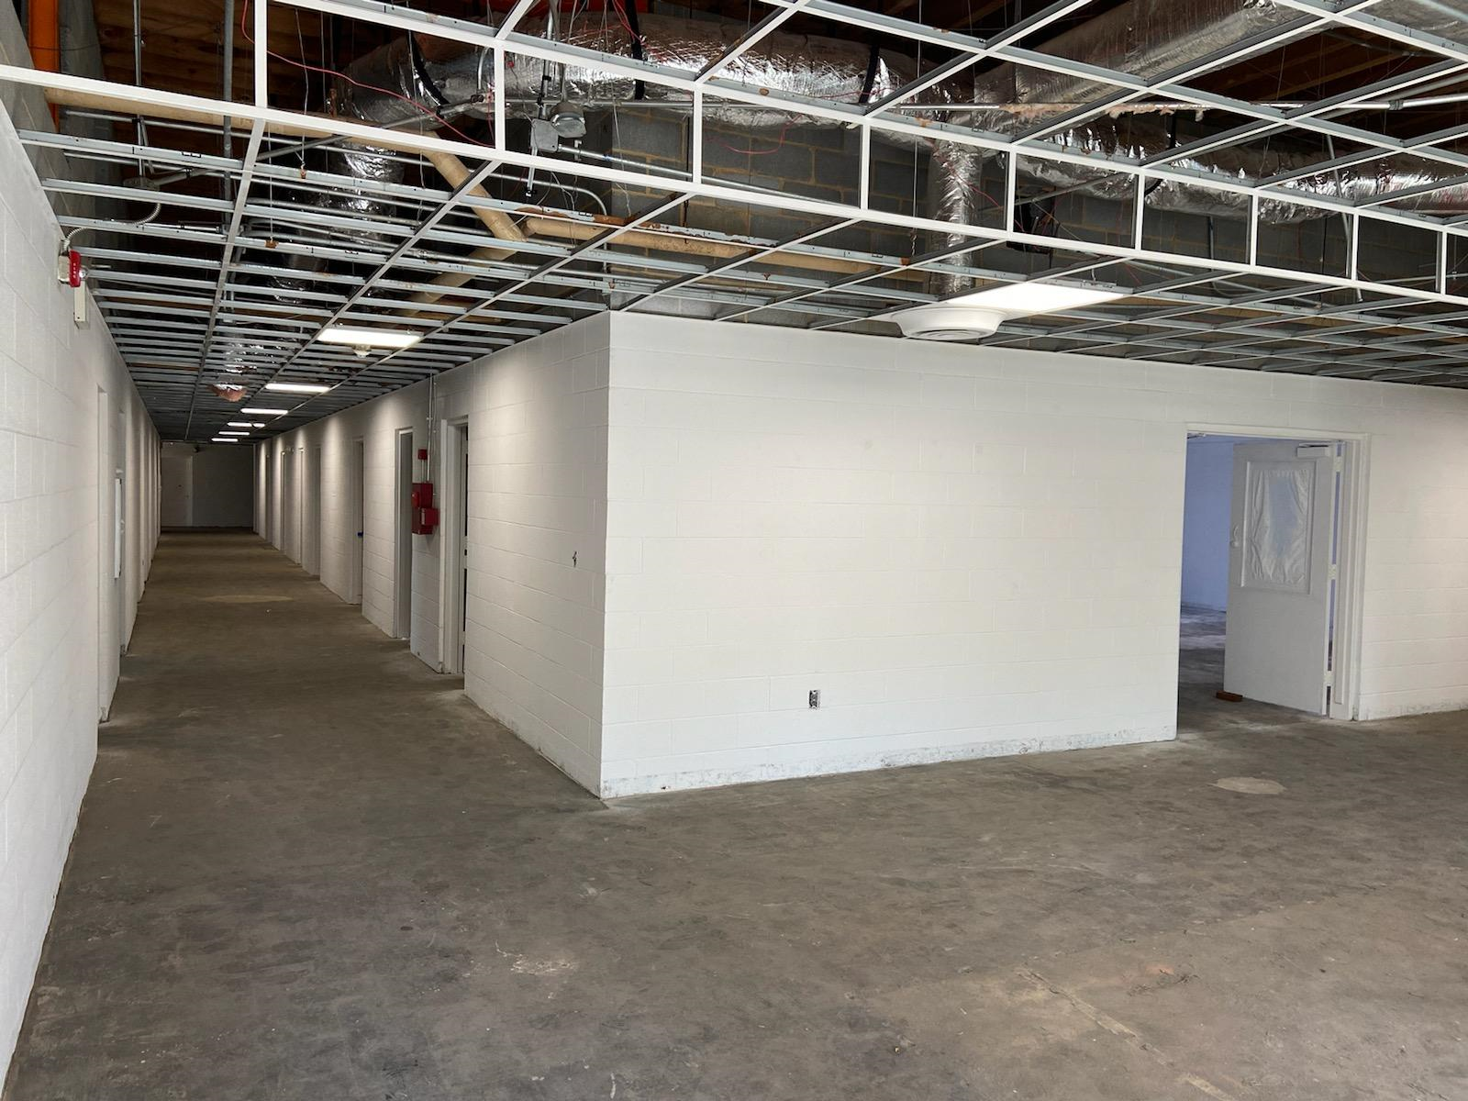
New State-Corporate –County Partnership
New Eckerd 40 (+) Bed Male Short-term Residential Facility in Yanceyville, NC
Admission ready date of Oct 1, 2021
Notes:
The section had been focused upon bed capacity expansion and had been actively seeking a site for the past 18 to 24 months to support short-term residential program bed expansion for males. The site came to our attention by way of David Carter, Chief Court Counselor in the 9th district whereby information was shared with DJJ leadership about the owner, his intended use of the building (a former nursing home in Yanceyville, NC) , and his interest in possibly supporting out mission after discussion with David.
After meeting with Zach Stout, the owner and proprietor of Runner Capital LLC Group from Chapel Hill, along with Eckerd and DJJ leadership, Mr. Stout halted the project, changed his intended purpose for the building and began working to support our mission. After site tours were facilitated and DJJ executed a contract amendment with Eckerd for programming expansion to the site, Eckerd leased the property, and Mr. Stout is prepared to upfit the building for our purposes. Capital Runner will within 60-days modify the building to meet the NC DHHS Licensing standards, allowing time for a sprinkler installation. The town of Yanceyville welcomes the opportunity to bring 53-full time jobs into their community.
This is truly a great example of NCDPS-ACJJ partnering with a business owner, Runner Capital, LLC, a private Non-Profit organization Eckerd, and local and county government to assist our most vulnerable juveniles and families in need. This is a win-win for all.

Slide 20
Eckerd Connects
All Programs
https://www.youtube.com/watch?v=eL_LDuWsm80
Boomer
https://www.youtube.com/watch?v=eL_LDuWsm80
Candor
https://vimeo.com/546161986/bbcdfd446f
Eckerd Girls Academy At Kerr Lake
https://youtu.be/tYHTa-sBxJI
Notes:
This year also brought a unique opportunity for the section to re-bid our female short-term residential programs. This Contract Bid and award is consistent with JJACs recommendations to provide age- appropriate resources to our RtA population. The residential program model specifically addresses the needs of our female population and is trauma-focused in its delivery of services. It is also responsive to re-entry needs and may serve as a stepdown service for those female juveniles that need additional supports when released from YDCs.
There were many firsts involved with this contract re-bid and award.
1. We transition from the former contracted residential provider to Eckerd's Girls Residential Academy while there were youth enrolled in the program, residing on the campus. This is the first time Juvenile Justice has transitioned a program with the youth and staff present at the program. The contract transition occurred on 9/1/2020 during the height of the pandemic and The program was fully transitioned from one contracted provider to a newly awarded contract provider without disruption of services
2, During this transition Eckerd retained 95% of the staff that were employed by the prior provider,
3. A transition of a site residential facility licensure (issuance to a new provider on the site) while occupied was a new experience for us as well as for our DHHS fellow state employees- Defer to Ms. Stella Bailey to get reaction

Slide 21
Cindy Porterfield, Director
Juvenile Community Programs
Cindy.Porterfield@ncdps.gov
919-324-6287

