Slide 1


Basic Security Guard Training
Field Note Taking and Report Writing

Slide 2

Field Note Taking & Report Writing

Slide 3

Training Objectives
List the purposes of writing and using field notes to effectively capture information.
Determine the four purposes of report writing.
Identify the six characteristics of a good report.
Demonstrate how to effectively write a narrative report using who, what, when, where, how and why as the questioning strategies.

Slide 4



Notes Can Be Permanent
Notes provide a greater degree of accuracy than memory
Retain your notes for at least 1 – 2 years
Check Company policy for retaining/destroying notes

Slide 5

Notes are an Aid in the Investigative Process
Failure to take notes result in inability to recall facts relating to the incident
Note all the activities, information, evidence or other facts discovered during the investigation
They help the investigators to pinpoint other facts to prompt re-examination of the scene

Slide 6
Security guard’s notes should Include:
Your arrival and departure time
Victim statements
Witness statements
Evidence found
Suspect information
Detail of the crime
Crime Scene Diagram
Weather conditions
Lighting conditions

Slide 7
Notes can aid in Courtroom Testimony
Your notes become a form of evidence
Statements are made, names and addresses are obtained, descriptions are given, and measurements are taken
Testimony should not be based on memory alone
Important details could be forgotten or cause you to give inaccurate information

Slide 8
Your Field Notes can be used as a log
Record events and circumstances that happened during your shift.
Daily Activities should be put in chronological order.
Your field notebook becomes a primary source of documentation of your activities and observations while at work.

Slide 9






Helpful Note Taking Hints
Write what happened in chronological order.
Include all names, positions, titles, etc.
Include addresses, telephone numbers, etc.
Explain in simple terms what happened
Use your notes, not memory, to write the report
Write the report as soon as possible

Slide 10
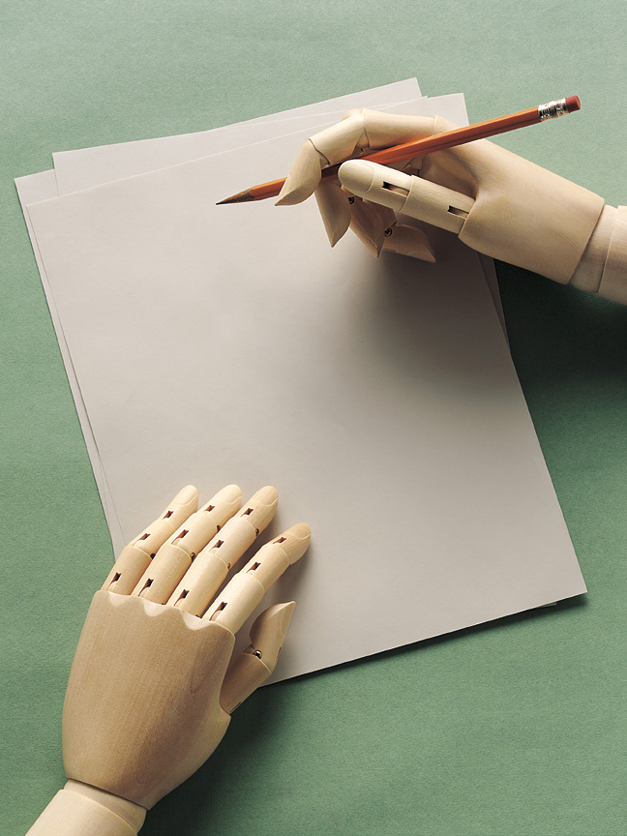
Why write a report?
To inform
To record
To demonstrate alertness
To protect yourself

Slide 11

To inform
  “Every report you write may be read by many individuals:
    Supervisors and Other immediate working staff
    Clients and their staffs
    Police/Sheriff’s Officer – Follow-up investigators
    Attorneys – Prosecution, Defense, Civil, Judges
    Media Representatives – Newspapers, radio, TV
    Regulatory agencies – DMV, Insurance Commissioners, ABC, Consumer Affairs
    Medical professionals – Dr’s, Psychiatrists, & Psychologists.

Slide 12
To Record
Accurate reports reduces the chance of misunderstanding an error
Do not use pronouns such as “he” or “she”
Use Proper Names: Mr. Jones, Sally Smith
Never trust to memory what can be recorded on paper, events, dates, times, etc., can be forgotten

Slide 13
To Demonstrate Alertness
● Your report informs your supervisor and client of the job you are doing and maintains a positive image.

Slide 14
PROTECT YOURSELF
DOCUMENT EVERYTHING

Slide 15
Characteristics of a Good Report
Clear
Legible
Complete
Accurate
Objective
Prompt

Slide 16
Clear
The language and structure must be simple and to the point
Facts presented must follow a logical order
Use simple words to clarify
Avoid using words that may have double meanings, slang, jargon, and unnecessary abbreviations
Write in the first person, use “I” instead of “This writer” or “this officer”

Slide 17

Legible
When handwritten, notes must be easy to read
Print if necessary
Make your letters clear and distinct
Avoid using “personal” shorthand – it is foreign to others
Others must be able to read your report and know what occurred

Slide 18
Complete
All facts should be included
Omitting facts could result in legal actions/problems
The following questions should be answered:
  Who
  What
  When
  Where
  How
  Why

Slide 19
Accurate
Reports must be based on facts.
Opinions and theories are proper only when requested and clearly labeled as such.
Names, phone numbers, etc. Should be double-checked for correctness.

Slide 20
Objective
Tell both sides of the story
Don’t be influenced by emotion, prejudice or opinion
Report should be based on facts alone

Slide 21
Prompt
Report should be completed as soon as possible
Always before ending your shift

Slide 22
Six Elements of a Report
Who
What
When
Where
How
Why

Slide 23
WHO?
WHO did it?
WHO is the victim?
WHO witnessed?
WHO is the owner?
WHO was notified?
WHO made the notification?

Slide 24
WHAT?
WHAT happened?
WHAT evidence is present?
WHAT elements of a crime are present?
WHAT property is missing?
WHAT damages or injuries occurred?
WHAT did you do?

Slide 25
WHEN?
WHEN did it occur?
  Time
  Day of the week
  Date
WHEN was it reported?

Slide 26
WHERE?
WHERE did the incident occur?
WHERE did it start/finish?
WHERE were the witnesses or/and suspect?

Slide 27
HOW?
HOW was entry gained?
HOW was the person injured?
HOW was the damage done?

Slide 28
WHY?
WHY was the person injured?
WHY did the accident occur?
WHY was the person in an unauthorized area?
WHY was the item taken?

Slide 29
Report Writing Practical Exercise
Facts:
You work for a major department store as a security guard and are monitoring the video surveillance cameras. You observe a shoplifting incident. You observe the subject exchange the shoes she is wearing with a new pair from a box on the shelf. You notify staff and the subject is apprehended at the main entrance of the store. The subject is led back to the office and the box containing the old shoes was retrieved from the shelf by the clerk in the shoe section.
Assignment:
Write a complete narrative concerning the event about. You have a maximum of 30 minutes to complete the assignment.

Slide 30
Training Objectives
List the purposes of writing and using field notes and how to effectively capture information.
Determine the four purposes of report writing.
Identify the six characteristics of a good report.
Demonstrate how to effectively write a narrative report using who, what, when, where, how and why as the questioning strategies.

Slide 31

Questions?

