Slide 1


Basic Security Guard Training
Deportment-Professional Standards

Slide 2

Training Objectives
Define “deportment” and determine the attitude and conduct required of a competent and professional Security Guard.
Identify and determine effective verbal and nonverbal communication.
Demonstrate the positive and negative effects of body language, gestures and slang.
Determine the general responsibilities of a Security Guard while working.
List the Security Guard Code of Conduct guidelines.
Apply sensitivity and correct procedures when dealing with disabled individuals at the work site.

Slide 3
Deportment
Webster’s dictionary defines deportment as “the way one behaves or acts”

Slide 4


Level of Conduct
Knowing your role in the state.
Learning your duties where you are working.

Slide 5

Perspectives
How people and things react to you
How you react to people and things.

Slide 6
Personal Appearance
General Appearance of Security Officers
  Must be neat and clean
  Wear the uniform as prescribed
  Project a professional image
  People will react to you with Respect

Slide 7
Personal Appearance-Hygiene
Bathe regularly
Keep hair combed and neatly trimmed
Shave when necessary
Pay attention to basic cleanliness

Slide 8



Morale
Low morale can lead to complacency and inattention to duties
Increased turnover, tardiness and absenteeism
Talk to your supervisor

Slide 9
Verbal/Nonverbal Communications
One of the most prevalent ways that you will be evaluated as a Security Professional is by the way you communicate both verbally and nonverbally with the public and fellow officers.

Slide 10
Vocal Qualities
Does every word and sentence you speak sound the same?
Do you sound tired and bored? Or energetic and interested?
Is you tone tight? Nasally? Breathy?
Do you mumble?
Do you speak too softly?
Do you speak too fast?
Do you speak too slow?
Do you sound hesitant and unsure?

Slide 11

DO NOT USE!
SLANG
PROFANITY

Slide 12
Addressing Individuals
Sir
Ma’am
Mr. Jones
Mrs. Jones

Slide 13
Nonverbal Communications
Posture, gestures, tone of voice, etc.
90% of the meaning of a conversation is nonverbal
Paralanguage

Slide 14

Paralanguage
Paralanguage addresses qualities such as:
  Voice pitch
  Range
  Sound Quality
  Resonance
  Speed; speech difficulties (lisping/stuttering)
  Body language accounts for 55% of the message/ 35% is paralanguage

Slide 15
Voice Characteristics
Pleading or Questioning tone
Enunciation may be poor
Pitch may be too high
Voice does not command attention and respect

Slide 16
“Loaded Words”
Some words can’t be used in a neutral and objective description
Lazy
Incompetent
Stupid
Unmotivated
Worthless
The more loaded the language, the more likely the person will become defensive.

Slide 17
“You” Statements
“You” followed by a Loaded word or phrase.
What are “you” doing here? Replace with “Can I help you, Sir?”
“You” are not telling me the truth! Replace with “I need you to be perfectly honest with me.”

Slide 18
Body Language Cues
Hesitation
Lack of eye contact
“Looking through you” eye contact
Interruption
Tense, impatient posture
Slumping, downtrodden posture

Slide 19
Remember that a message is…
7% What is said
38% How it is said
55% Non-verbal communications

Slide 20
Personal Space
Intimate Zone 6 to 18 inches
Personal Zone 1 ½ to 2 ½ feet
Close phase 4 to 7 feet
Social Zone 4 to 12 feet
Far phase 7 to 12 feet
Public Zone 12 to 25 feet

Slide 21
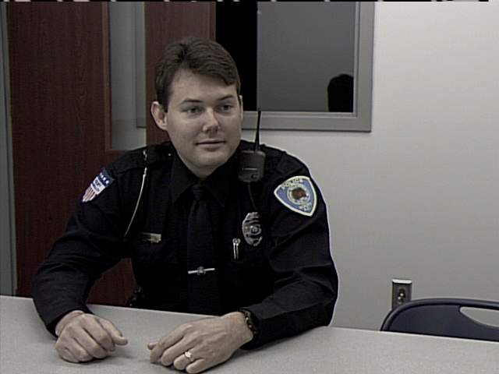
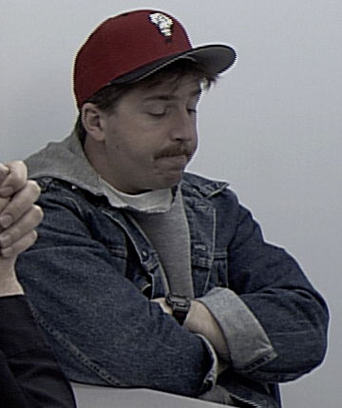
OPEN vs. CLOSED
Body Positions

Slide 22
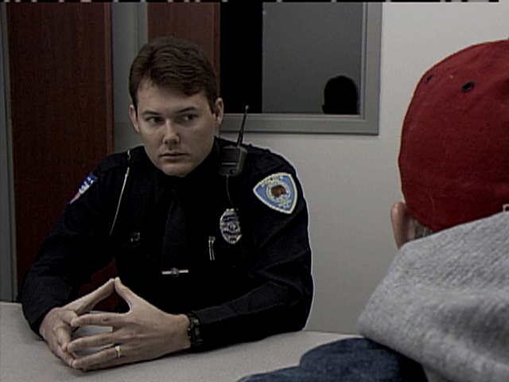
STEEPLED FINGERS

Slide 23
CALM FACIAL FEATURES
OPEN HANDS/ARMS

Slide 24
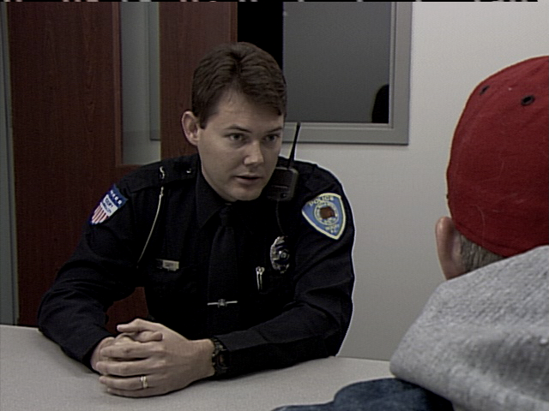
LEANING FORWARD

Slide 25
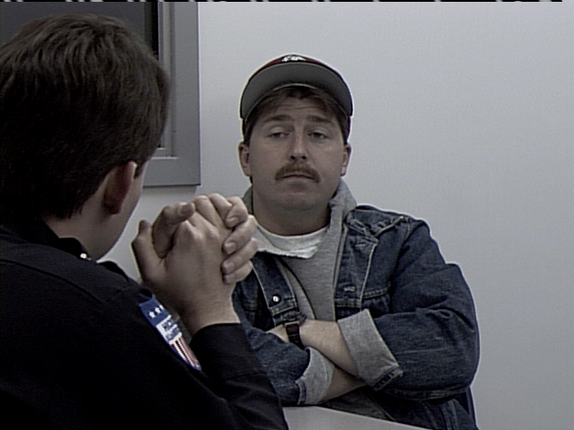
STARING

Slide 26
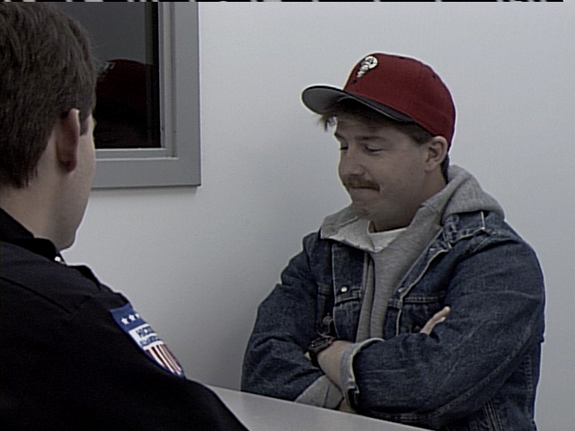
CROSSED ARMS

Slide 27
Hostile Cues
Smile with dead eyes
Posture and rigidity
Defiant eyes and verbiage
Tight jaws
Ignores guard’s presence
Will not relinquish control
Will not communicate
Clinched fists
Shallow breathing
Shaking or nervous twitches
Alcohol/Drug use

Slide 28



Body Language
The non-verbal message must match the verbal message
Volatile situations can be agitated or calmed by body language
Match or mirror body language

Slide 29

Security Officers are NOT Police Officers

Slide 30




Laws
No powers of arrest
Avoid the Use of Force
Respect the citizen’s rights
Be courteous

Slide 31
Conduct on Post
Positive attitude
Professional image
Good moral character
No alcohol/drug use
No smoking on post
No horseplay

Slide 32
Follow the Protection Officer Code of Conduct in all that you do….

Slide 33
Guidelines of Conduct
Respond to the employer’s professional needs
Exhibit exemplary conduct
Protect confidential information
Maintain a safe & secure workplace
Dress to create professionalism
Enforce all lawful rules & regulations
Encourage liaison with local emergency services
Develop good rapport with fellow members
Strive to maintain competence
Encourage high standards of officer ethics

Slide 34
Special Populations
Deaf/Hearing Impaired
Blind/Vision Impaired
Mobility Impaired
Elderly
Special Needs
Cultural Awareness

Slide 35
Training Objectives
Define “deportment” and determine the attitude and conduct required of a competent and professional Security Guard.
Identify and determine effective verbal and nonverbal communication.
Demonstrate the positive and negative effects of body language, gestures and slang.
Determine the general responsibilities of a Security Guard while working.
List the Security Guard Code of Conduct guidelines.
Apply sensitivity and correct procedures when dealing with disabled individuals at the work site.

Slide 36

Questions

