Slide 1
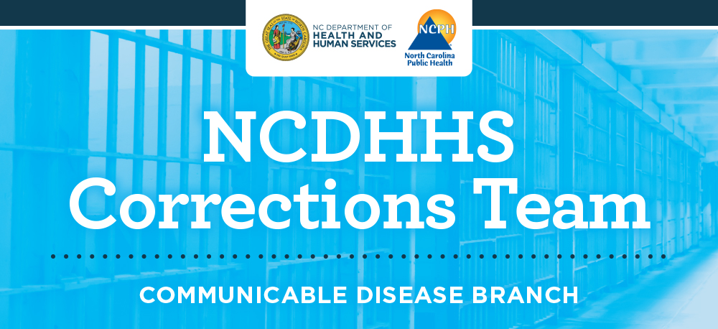

Slide 2
NCDHHS Communicable Disease Branch Corrections Team
The North Carolina Department of Health and Human Services Corrections Team serves as a resource to correctional entities to strengthen and improve the delivery of healthcare, assist in infectious disease prevention and control, and statewide support to ensure the health and wellbeing of detained and incarcerated persons in the state of North Carolina.
Our Mission
To serve as a resource to strengthen and support the delivery of healthcare and infectious disease prevention for correctional entities of our state.
Our Vision
To be regarded as the leading corrections team within any DHHS across these United States.
Our Goals
Develop working relationships with stakeholders to establish credibility and collaborative partnership to effect any needed change in the delivery of healthcare services.
Provide technical assistance with COVID-19 mitigation to correctional entities.
Promote correctional healthcare best practices based on national correctional standards.
Provide opportunities for local correctional entities to enhance their service delivery.
Inform correctional health entities of state and/or national legislative guidance that may be helpful in their provision of services.
Our Team Members
Over 60 combined years of correctional experience
2 medical consultants, 3 nurse consultants, 1 program manager, 1 contract administrator, 6 contract monitors, & 1 administrative officer

Slide 3
Corrections Team Activities
COVID Mitigation
Provide technical assistance with COVID-19 outbreaks and mitigation to local confinement facilities. Including partnering with DPS at the top of the pandemic to create an ongoing communication related to COVID and other health related matters
COVID Mitigation
Provide technical assistance with COVID-19 vaccinations within local confinement facilities
ELC Grant Management
Joint CDC/DOJ $20,230,000 Grant distribution to DPS and Local Confinement Facilities
ELC Grant Management
Develop and implement Grant associated workplan components to include quarterly educational webinars and printed materials on various COVID and non-COVID health topics
Jail Health
Develop partnerships with various agencies/organizations to identify resources, provide training, and create education materials specifically for the corrections staff and their detained population.
Jail Health
Provide access to correctional health resources throughout our state in a central location using our webpage (NCDHHS Communicable Disease Branch Corrections Team | NCDHHS) and jail health toolkit
COVID Mitigation
Provide real-time updates on COVID-19 guidance and other important announcements to confinement facilities and community partners using our email marketing platform
COVID Mitigation/Network
Create an atmosphere of information sharing among confinement facilities while highlighting key COVID-19 information through our quarterly newsletter
Jail Health
Field correctional health related calls/inquiries from various organizations/individuals

Slide 4

Jail Health toolkit

