Slide 1


Basic Security Guard Training
Traffic Directions and Control

Slide 2
Traffic Direction and Control

Slide 3

Training Objectives
Identify situations that require traffic direction and necessary equipment to perform the task.
Demonstrate proper hand signals and gestures when controlling the flow of traffic.
Demonstrate effective traffic control procedures utilizing the following signaling aids:
    Whistle
    Voice
    Illuminated Baton
    Signal Flare
List various factors that can complicate traffic direction at an accident or fire scene.

Slide 4
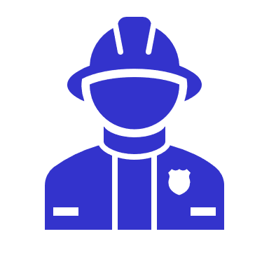
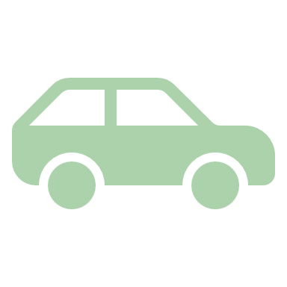

Situations for traffic direction
Accidents, fires and other emergencies
Congestion
Heavy traffic

Slide 5
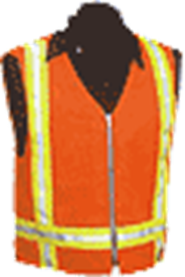


Equipment
Daytime
  Reflective Vest
  Whistle
  Highly visible gloves
Nighttime
  Flashlight and/or Traffic Baton
All weather gear

Slide 6

Center of the Intersection
Greatest visibility
Most hazardous
Provides greatest control

Slide 7
Corner Position
Used primarily where pedestrian traffic is heavy
Safer for the guard and pedestrians

Slide 8

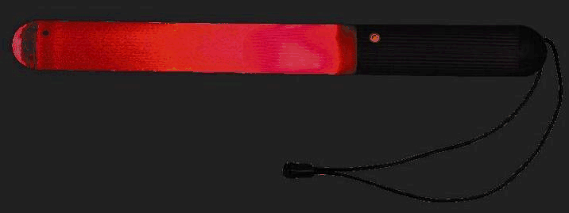

Signaling Aids
Use of the Whistle
One Long Blast – STOP
Two Short Blasts – GO
Several Short Blast – to get attention
Voice
Illuminated baton
Flares

Slide 9
Traffic Control at Accidents
Keep vehicles and spectators from danger areas.
When moving vehicles, be mindful of emergency vehicles and equipment
Watch for fuel leaks or combustible materials
Coordinate emergency service personnel in and out of area

Slide 10

Traffic Control at Fires
Keep all vehicle and pedestrian traffic beyond the established fire line
Coordinate enforcement and traffic direction and activities with the fire department officials

Slide 11
Training Objectives
Identify situations that require traffic direction and necessary equipment to perform the task.
Demonstrate proper hand signals and gestures when controlling the flow of traffic.
Demonstrate effective traffic control procedures utilizing the following signaling aids:
    Whistle
    Voice
    Illuminated Baton
    Signal Flare
List various factors that can complicate traffic direction at an accident or fire scene.

Slide 12

Questions?

