Slide 8
Addressing violence as a public health issue
David Johnson Bull City United Supervisor

Slide 9
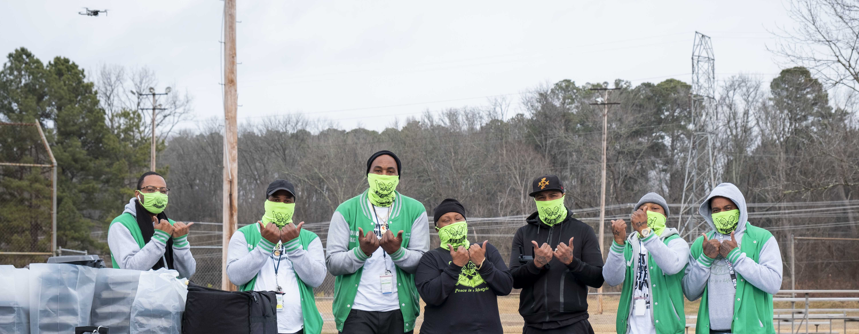
Bull City United is part Durham County Public Health, focused on violence prevention and intervention.

Slide 10
Cure Violence Model
Detect and interrupt potentially violent conflicts
Prevent retaliations
Mediate ongoing conflicts
Identify and treat highest risk
Access highest risk individuals
Mobilize the community to change norms
Respond to every shooting
Spread positive norms
Keep conflicts ‘cool’
Change behaviors
Help obtain needed social services

Slide 11
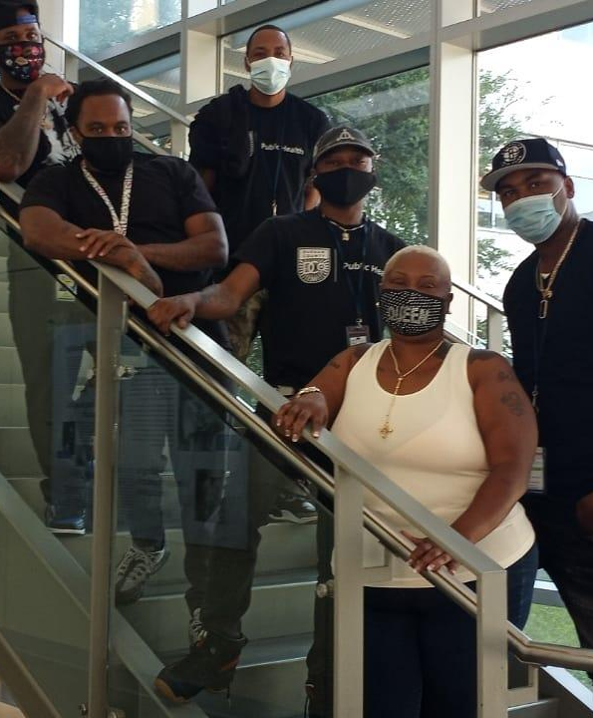
TEAM STRUCTURE
SUPERVISOR: David Johnson
VIOLENCE INTERRUPTERS
Matthew Harrington
Dwight Bagley
Charles Johnson
OUTREACH WORKERS
Convellus Parker
Keshia Gray
Carlos McCledon

Slide 12
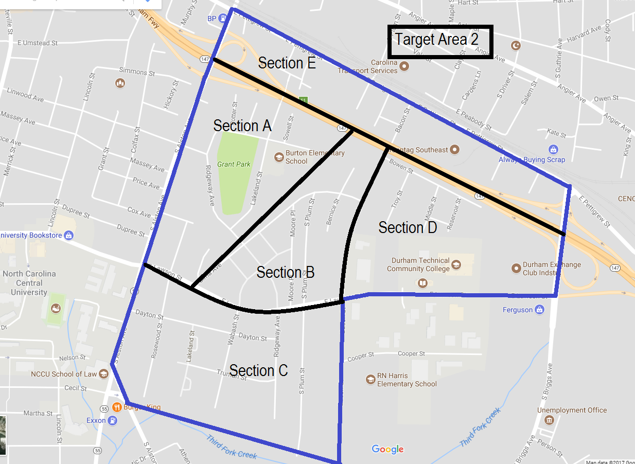
Program area selected based on data
Targeted Census Tracts
TA1: 1400 (McDougald Terrace) TA2: 1301 (Southside)

Slide 13
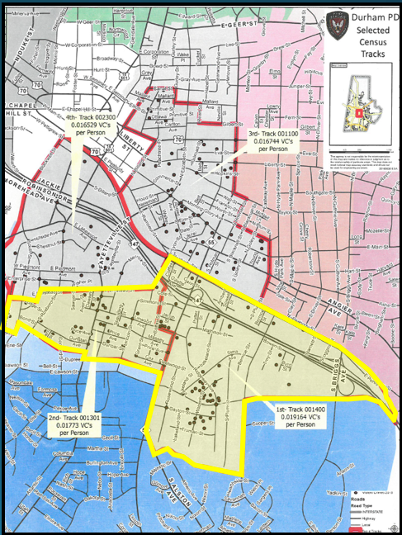
Targeting our focus
Examining the data in 2015:
Census tract 1400 0.0191 violent crimes per person (highest in the city of Durham)
Census tract 1301 0.0177 violent crimes per person (2nd highest in the city of Durham)

Slide 14
Responding to violence in Target Areas
Jan – April: 2021 | Mediations | Shootings | Homicides
January | 40 | 2 | 0
February | 61 | 0 | 0
March | 73 | 0 | 0
April | 59 | 1 | 0
Notes:
Comparing target areas with the City of Durham YTD ending 9/28 comparing 2018 to 2019 data:
Homicide is up 39%
Non domestic aggravated assault with a firearm is up 32.5%

Slide 15
Mediations, January – April 2021
233 conflict mediations, involving 581 individuals
45% due to personal altercations
19% gang disputes
9% conflicts over theft/robbery
10% conflicts over narcotics
7% domestic violence
9% other
61% of the mediations involved conflicts that were likely or very likely to result in a shooting.
80% of the mediations successfully resolved the conflict at least temporarily or as long as certain conditions were met.

Slide 16
Participants
43 individuals included as case load, January – April 2021
Multiple risk factors, making high potential for involvement in violence
Gang involvement
Prior Criminal History
Involved in street activity highly associated with violence
Carries a firearm
Someone close to participant (family member or gang/group/clique/crew/etc. member) was a recent victim of a shooting
Individual was shot within last 90 days
Recently released from prison; underlying offense was a violent crime

Slide 17
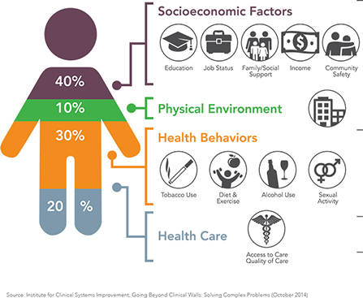
Impact on Participants
91% connected to employment
57% of participants employed
100% received services to change behaviors
79% showed gun related behavior change

Slide 18
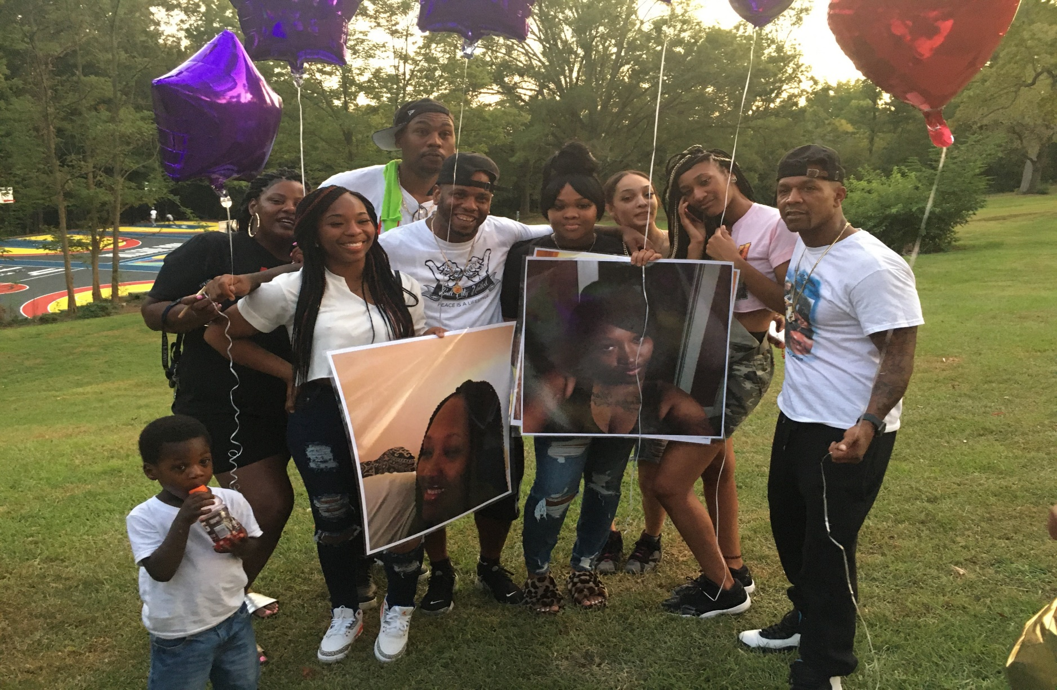
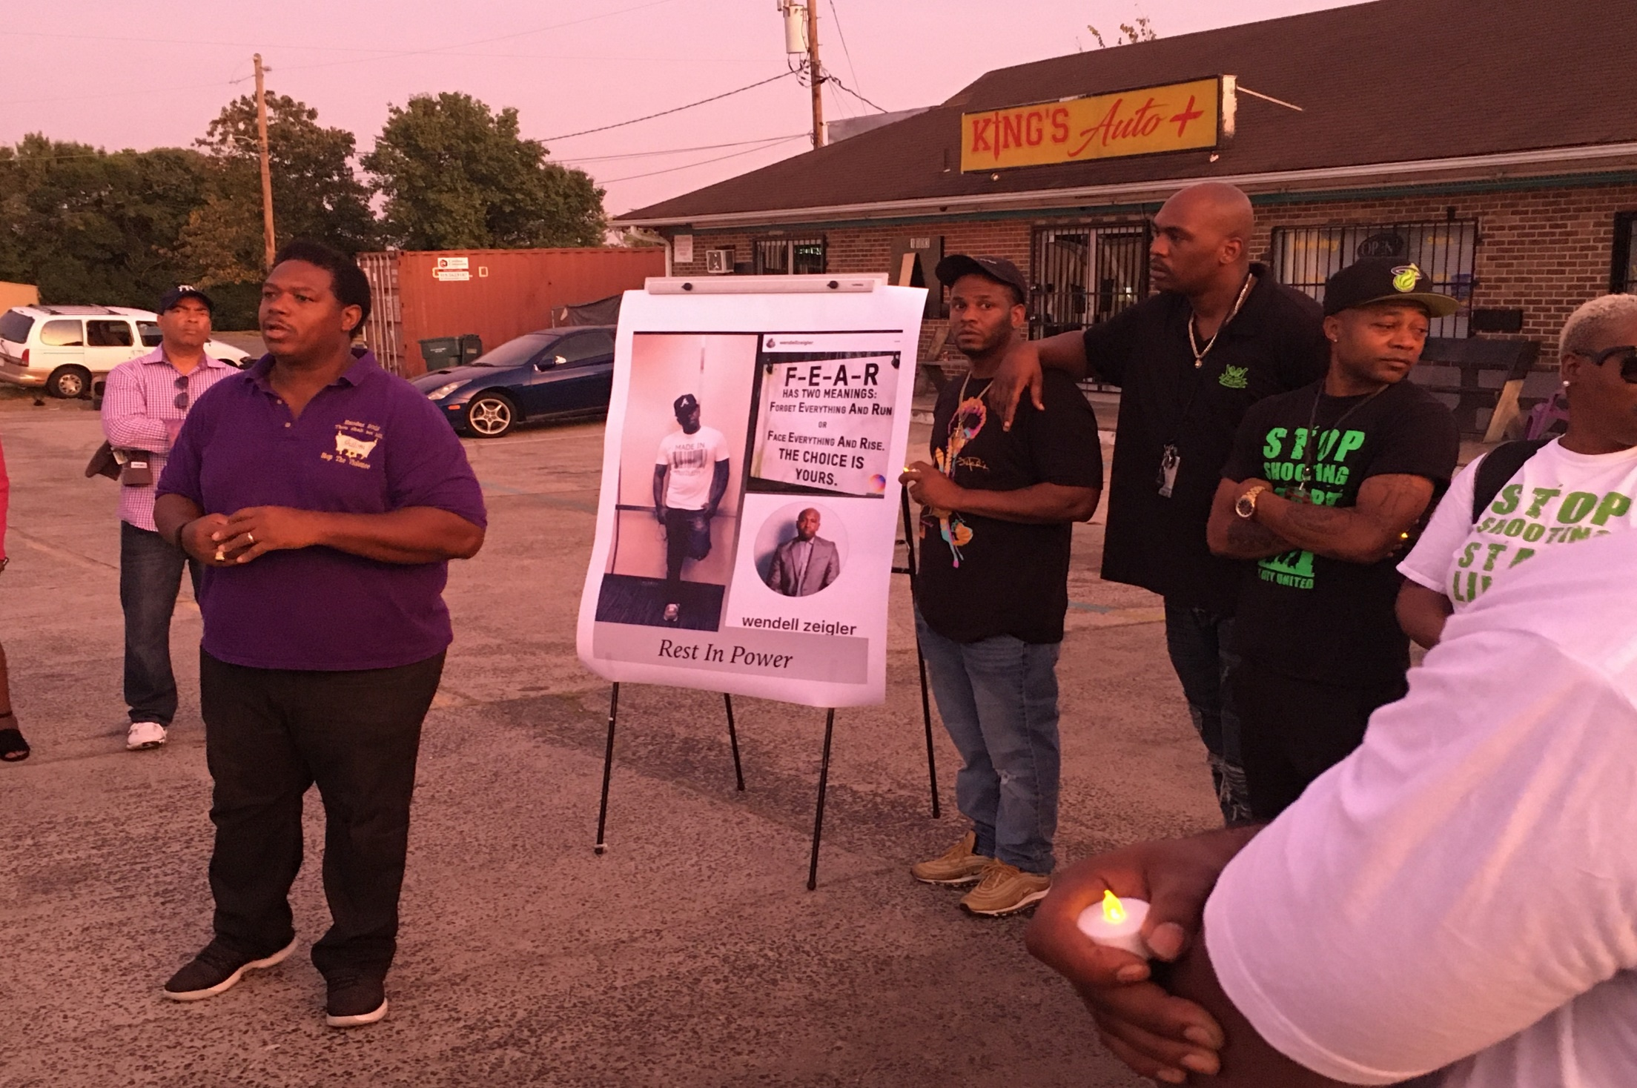
Events
Week of Peace: February 1st - 5th
United for Peace: April 14th – 17th
McDougald Reunion: April 17th
Spring Fling: April 20th – 23rd
Notes:
David

Slide 20
New Funding Opportunities for Violence Prevention and Intervention
Kyle Fischer, MD, MPH
Policy Director, the HAVI

Slide 21
Overview - Funding Opportunities
Immediate Funding Opportunities + Action Steps
American Rescue Plan
Federal Community Violence Grants
Potential Funding Opportunities + Action Steps
$5B Commitment from Biden Administration
Legislation
Medicaid

Slide 22
CORONAVIRUS STATE AND LOCAL FISCAL RECOVERY FUNDS
The American Rescue Plan invests hundreds of billions of dollars in “Coronavirus State and Local Fiscal Recovery Funds” that governors, mayors, and county executives can use to fund violence prevention, trauma recovery, reentry, and community development organizations in the following ways:
“To respond to the public health emergency with respect to the Coronavirus Disease” (COVID–19)
“To respond to negative economic impacts,” including assistance to “nonprofits”
“To provide grants to eligible employers that have eligible workers who perform essential work” (Sec. 9901)
Advocacy Brief: HERE

Slide 23
Treasury Department Guidance:
Page 22:
Given the exacerbation of health disparities during the pandemic and the role of pre-existing social vulnerabilities in driving these disparate outcomes, services to address health disparities are presumed to be responsive to the public health impacts of the pandemic. Specifically, recipients may use payments from the Fiscal Recovery Funds to facilitate access to resources that improve health outcomes, including services that connect residents with health care resources and public assistance programs and build healthier environments, such as:
Evidence-based community violence intervention programs to prevent violence and mitigate the increase in violence during the pandemic.

Slide 24
New Opportunities
Link to White House Announcement

Slide 25
Immediately:
26 Separate Federal Funding Streams identified for violence prevention services
Across multiple agencies:
DOJ, HHS, HUD, Education, Labor

Slide 26
Examples…
AGENCY | TOTAL | SITE LINK
Department of Justice | $758,650,000
Byrne JAG | $484,000,000 | https://bja.ojp.gov/program/jag/overview
Byrne Criminal Justice Innovation | $18,900,000 | https://bja.ojp.gov/funding/opportunities/o-bja-2021-60003
Community Policing Development | $3,000,000 | https://cops.usdoj.gov/cpdmicrogrants
Cops Hiring Program | $156,000,000 | https://cops.usdoj.gov/chp
Smart Policing | $8,000,000 | https://www.ojp.gov/funding/explore/current-funding-opportunities#OpenSols
Second Chance Act | $12,750,000 | https://bja.ojp.gov/funding/opportunities/o-bja-2021-58002
Strategies to Support Children Exposed to Violence | $7,000,000 | https://ojjdp.ojp.gov/programs/children-exposed-violence
Comprehensive Youth Violence Prevention and Reduction | $11,000,000 | https://www.ojp.gov/funding/explore/current-funding-opportunities#OpenSols
School Violence Prevention Program | $53,000,000 | https://cops.usdoj.gov/svpp
Hospital-Based Victim Services | $2,000,000 | https://www.ojp.gov/funding/explore/current-funding-opportunities#OpenSols
Center for Culturally Responsive Victim Services | $3,000,000 | https://www.ojp.gov/funding/explore/current-funding-opportunities#OpenSols
Project Safe Neighborhoods | guidance | https://bja.ojp.gov/program/project-safe-neighborhoods-psn/overview
National Gang Center | guidance | https://ojjdp.ojp.gov/programs/national-gang-center
Victims of Crime Act | guidance | -

Slide 27
Medicaid
Additional Medicaid Resources at www.thehavi.org/additionalresources

Slide 28
Working Towards Victory - $5 Billion
The HAVI is part of #FundPeace coalition of Black and Brown led Gun Violence Prevention Groups that worked together to achieve this incredible milestone.
Eddie Bocanegra, Heartland Alliance
Dr. Shani Buggs, University of California – Davis
Dr. Antonio Cediel, Faith in Action/LIVE FREE
Mike De La Rocha, Revolve Impact
Erica Ford, LIFE Camp, Inc.
Greg Jackson, Community Justice Action Fund
Fatimah Loren-Dreier, Health Alliance for Violence Intervention
Pastor Mike Mcbride, Faith in Action/ LIVE FREE
Oresa Napper-Williams, Not Another Child
Anthony Smith, Cities United
Dr. Chico Tillmon, Gun Violence Prevention & Intervention Expert

Slide 29
Questions?
KyleF@TheHavi.org

Slide 30
VCU HEALTH INJURY AND VIOLENCE PREVENTION PROGRAM:
Hospital-Based Violence Intervention Programs (HVIP's)
BRIDGING THE GAP OVERVIEW

Slide 31
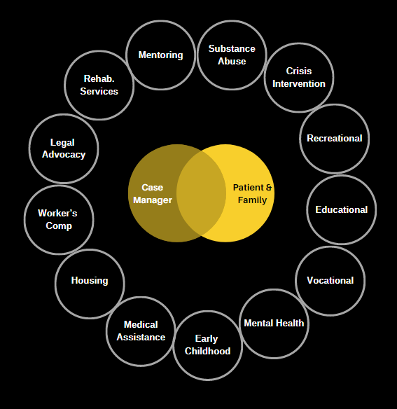
HVIP's
Multidisciplinary programs that bring together hospital staff with trusted community-based partners to provide safety planning, wrap-around services, and trauma-informed care to violently injured people
Engaging patients in the hospital, during their recovery, is a golden opportunity to improve lives and reduce retaliation and recidivism.

Slide 32
Hospital Intervention Provides a Unique Window of Opportunity

Slide 33
5
year re-injury rate for victims of intentional injury is
10-50%
Treat & Street to Treat Again
20%
are estimated to die as a result of subsequent violence
15%
VCU Trauma Registry reports a re-injury rate
trauma admissions per year -
firearm/stabbing
4,300
12%

Slide 34
VCU Health: Bridging the Gap
BTG is a hospital-based and community-integrated program that seeks to reduce violence. Through intensive case management and community partnerships work with clients to address disparities that contribute to violence.

Slide 35
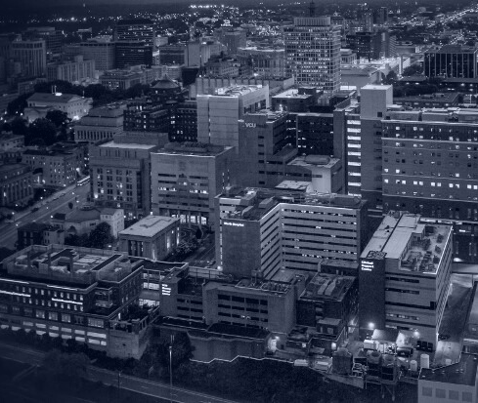
STANDARD OF CARE
Standard of care offered to all violently injured patients.
INTERVENTION AT THE BEDSIDE
A youth and adult violence intervention program.
EMERGING LEADERS
A youth violence prevention program.
WHAT BTG OFFERS...
Notes:
We offer services to ANY and ALL patients who walk through our door for violent intentional injury through our standard of care.
With Standard of Care patients receive information and referrals as well as advocacy at the bedside prior to discharge.
Intervention at Bedside on next slide
Emerging Leaders not discussed today, but is a youth violence prevention program aimed at high school freshman through senior year.

Slide 36
Relationship Building
Case managers follow patients while in the hospital to build rapport
Intervention at Bedside:
Intensive Case Management
Case managers assists the patient in accessing services, facilitating coordination between the systems involved, and providing a link to community resources..
Intervention Strategies for Youth and Adults
Community Reintegration
Case managers follow patients for up to a year to increase success and reduce recidivism

Slide 37
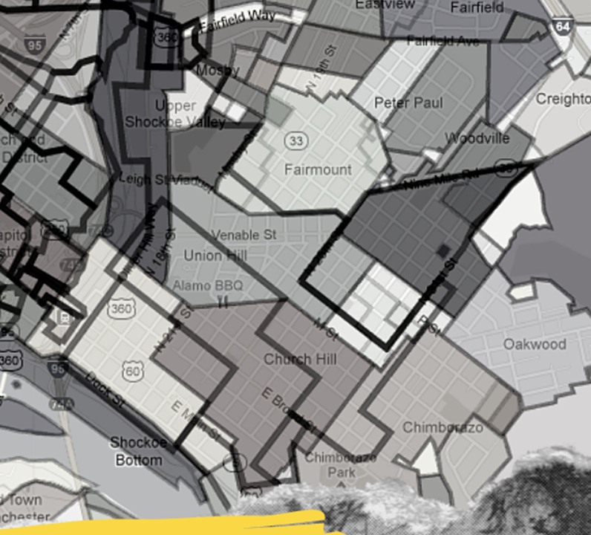
VCUHS + RICHMOND COMMUNITY
Effect of Community Based Intervention when Supplemented with Hospital-Based Brief Violence Intervention
Reduction in Recidivism
15% to 3.6 %
Reduction with short term risk factors
2.5x's less likely to use alcohol
Significant reduction in drug use
Hospital Service Utilization
Clinic Visits: 3.5x's more likely to schedule
ED Visits: 2.5x's more likely to use ED appropriately
Community Service Utilization
2.5x's and 3X more likely to use community services at 6wks and 6 mon respectively
>90% connected to community service within 6 months

Slide 38
Funding Needs
HVIP START UP BUDGET
VCU BTG
1 Program Coordinator
2 - 4 FTE case managers plus benefits
Emergency funds
Supplies (laptops, workspace, etc.)
Training
Local travel
Software program for data collection
Total: ~ $250-350K per hospital (Level I Trauma Centers)
Varied funding sources include VHHA/DCJS, VCUHS, Virginia Dept of Health
1 Program Manager
5 Case Managers
1 Therapist
4 Peer Support Specialists
Served YTD: 150 patients (estimated 300pts in '21)
VIRGINIA
Governor initiated investment:
$2.45 million through Victims of Crime Act (VOCA) funding through Hospital Association
Funded 5 HVIP's plus Training & Technical Assistance

