Slide 1
Raise the Age Update
July 16, 2021

Slide 2
JJAC
Began meeting December 4, 2017
Committee dissolves Feb 1, 2023 or upon filing of final report (report due by January 15, 2023)
Members serve until resignation
Majority constitutes quorum (11 of 21 members)
Tasked with monitoring and reviewing the implementation of the RtA expansion and making additional recommendations to the General Assembly as necessary

Slide 3
Upcoming
School Safety Summit on August 2, 2021 at UNC-Greensboro. Center for Safer Schools is planning a 2nd day of breakout groups focused on educational setting.
Discussions w/ General Assembly of minimum age with implementation of services
Racial equity training for all JJ staff and program providers

Slide 4
Delinquency Rates
18 months
Ages 6-15
Complaints per juvenile: 2.59
Ages 16-17
Complaints per juvenile: 2.85

Slide 5
RtA Complaints Received and Distinct Juveniles by Month

Slide 6
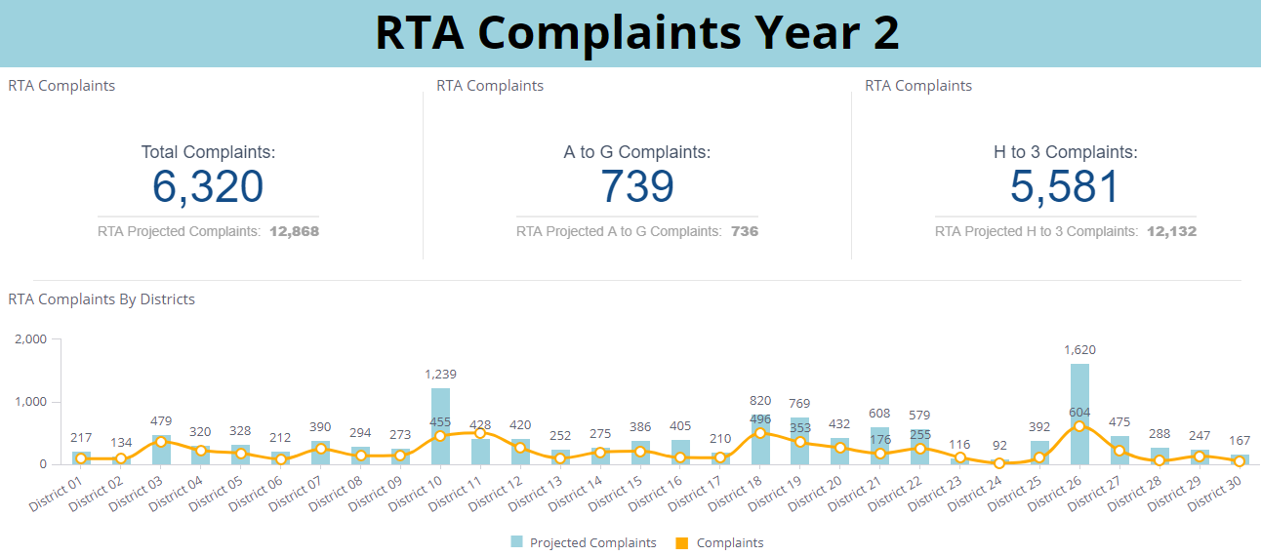
Year 2: Dec 2020- June 2021

Slide 7
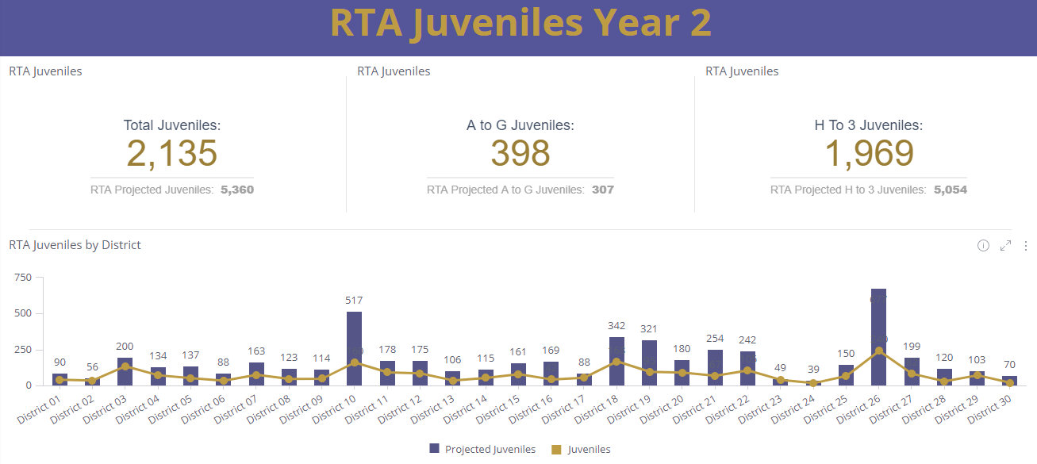
Year 2: Dec 2020- June 2021

Slide 8
RtA Complaints Received and Distinct Juveniles by Month
Slightly higher number of A-G juveniles and lower number of H-3 juveniles compared to year 1.

Slide 9
DETENTION
AVERAGE DAILY POPULATION (ADP)
From January 2020 through June 2021, the ADP increased 39%
76% of the detention pop on 7/5/21 was 16 or older. 63% were for A-G offenses.
What is causing the increase in population?

Slide 10
DETENTION ADMISSIONS
Covid pandemic
There is not a recent increase in detention admissions.
The average # of admissions per month is the same so far in 2021 as it was in 2019 (191 to 192).
Notes:
Jan 2020 highest month at 267 admissions
May 2020 lowest month at 86 admissions
Jun 2021 at 181 admissions

Slide 11
DETENTION EXITS: Non-TSC
AVERAGE LENGTH OF STAY (LOS)
For all juveniles who were not Transfers to Superior Court, the average and median lengths of stay have increased.

Slide 12
DETENTION EXITS: TSC
AVERAGE LENGTH OF STAY (LOS)
For juveniles who were Transfers to Superior Court, the average and median lengths of stay have increased.
On July 5th, the average length of stay for TSC youth in detention was 225 days (n=56 youth).
Notes:
2019 excluded because there were only 20 juveniles who exited detention with a LOS of 317 days, median 225 days. The sample is too small and the transfer mechanism prior to Raise the Age was reserved for the most serious and violent juveniles.
Tyranny of small numbers!

Slide 13
DETENTION EXITS: TSC
ADP, Minimum and Maximum Population
The Transfer to Superior Court average daily population is growing.
Year | TSC ADP
2019 | 17
2020 | 39
2021 YTD | 57

Slide 14
Transfers to Superior Court
Since Dec. 1, 2019, 459 juveniles* have been transferred to Superior Court
53% of transferred juveniles have been admitted to detention
In detention, transfers to superior court consist of approximately 25% of the population
Since October 2020, the TSC ADP has been 49 or higher
Since Dec. 1, 2019, an average of 24 juveniles a month are being transferred
  Jul – Dec 2020 average per month: 27.3
  Jan – Jun 2021 average per month: 28.3
*have a juvenile complaint that was moved into transferred status

Slide 15
Month | Max Population Hx and Forecast | Minimum 95 % Confidence Band | Maximum 95% Confidence Band
Jan 2020 | 201 | n/a | n/a
Feb 2020 | 215 | n/a | n/a
Mar 2020 | 218 | n/a | n/a
Apr 2020 | 173 | n/a | n/a
May 2020 | 167 | n/a | n/a
Jun 2020 | 186 | n/a | n/a
Jul 2020 | 201 | n/a | n/a
Aug 2020 | 220 | n/a | n/a
Sep 2020 | 224 | n/a | n/a
Oct 2020 | 243 | n/a | n/a
Nov 2020 | 239 | n/a | n/a
Dec 2020 | 248 | n/a | n/a
Jan 2021 | 228 | n/a | n/a
Feb 2021 | 248 | n/a | n/a
Mar 2021 | 256 | n/a | n/a
Apr 2021 | 241 | n/a | n/a
May 2021 | 261 | n/a | n/a
Jun 2021 | 271 | n/a | n/a
Jul 2021 | 271 | 249 | 294
Aug 2021 | 276 | 251 | 301
Sep 2021 | 281 | 253 | 308
Oct 2021 | 285 | 255 | 315
Nov 2021 | 290 | 258 | 322
Dec 2021 | 295 | 261 | 328

Slide 16
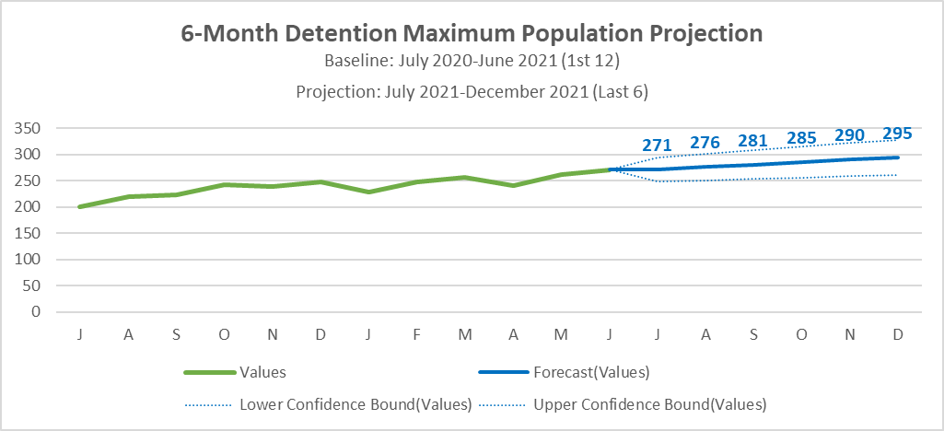

Slide 17

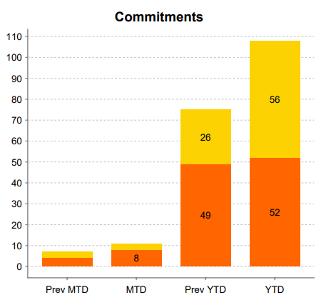
YDC Commitments

Slide 18

This Photo by Unknown Author is licensed under CC BY-NC

