Slide 1
Governor’s Crime Commission
Application Status Update #5
December 10, 2020
The meeting will begin at 2:00 p.m.
Please MUTE yourself or you will be muted by the host. There will be time for question and answer following the presentation both verbally and via the chat box.
We encourage you to request to speak by using the “raised hand” icon or the chat box.

Slide 2
Awards 2020 Summary
Began sending VAWA awards out week of 10/19/2020
  projects funded from older federal funds first
  projects funded from federal fiscal year 2020 last due to JustGrants.gov conversion error.
VOCA awards are starting to go out as of 12/9/2020 due to Justgrants.gov conversion
Justgrants.gov
DocuSign

Slide 3
Just Grants Conversion
VOCA 2019 can be awarded AND opened.

Slide 4
Just Grants Conversion
VOCA 2020 can be
  awarded
  DocuSign award documents signed
  Supplemental Forms signed (wet signature and scanned and uploaded by the applicant to GEMS)
  NOT opened until we see a balance in JustGrants.gov
  Why can’t these projects be opened?
  Without a balance in JustGrants.gov, we cannot pay your reimbursements!
Historically, GCC would not send awards to you without being able to pay your reimbursements, however, we are just waiting on a glitch to be fixed in JustGrants.gov.
The awarding process takes time so we will move forward with this step of the process and then once a balance shows in JustGrants.gov, we can begin opening grants immediately.
  Start preparing narratives and data for your NOGI and SARs

Slide 5
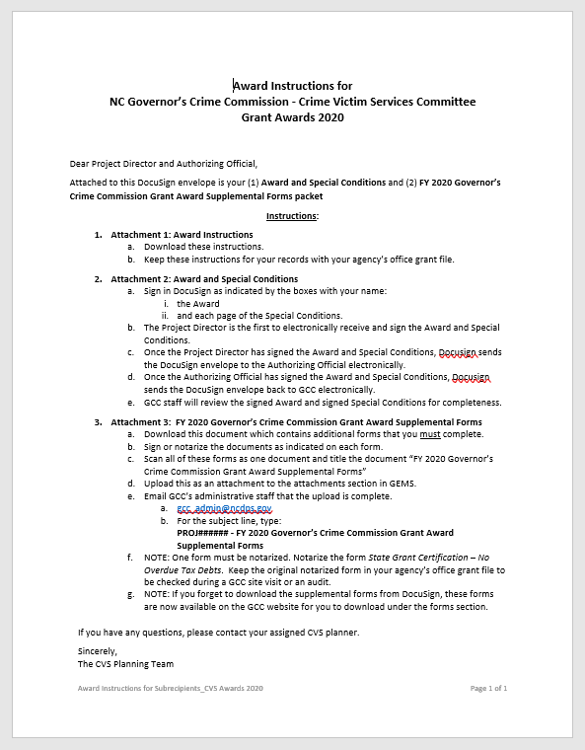
Award Instructions

Slide 6
Award Instructions
1. Attachment 1: Award Instructions
  Download these instructions.
  Keep these instructions for your records with your agency’s office grant file.

Slide 7
Award Instructions
2. Attachment 2: Award and Special Conditions
  Sign in DocuSign as indicated by the boxes with your name:
    the Award
    and each page of the Special Conditions.
  The Project Director is the first to electronically receive and sign the Award and Special Conditions.
  Once the Project Director has signed the Award and Special Conditions, Docusign sends the DocuSign envelope to the Authorizing Official electronically.
  Once the Authorizing Official has signed the Award and Special Conditions, Docusign sends the DocuSign envelope back to GCC electronically.
  GCC staff will review the signed Award and signed Special Conditions for completeness.

Slide 8
Award Instructions
3. Attachment 3: FY 2020 Governor’s Crime Commission Grant Award Supplemental Forms
  Download this document which contains additional forms that you must complete.
  Sign or notarize the documents as indicated on each form.
  Scan all of these forms as one document and title the document “FY 2020 Governor’s Crime Commission Grant Award Supplemental Forms”
  Upload this as an attachment to the attachments section in GEMS.
  Email GCC’s administrative staff that the upload is complete.
    gcc_admin@ncdps.gov
    For the subject line, type: PROJ###### - FY 2020 Governor’s Crime Commission Grant Award Supplemental Forms
  NOTE: One form must be notarized. Notarize the form State Grant Certification – No Overdue Tax Debts. Keep the original notarized form in your agency’s office grant file to be checked during a GCC site visit or an audit.
  NOTE: If you forget to download the supplemental forms from DocuSign, these forms are now available on the GCC website for you to download under the forms section - https://www.ncdps.gov/about-dps/boards-and-commissions/governors-crime-commission/grant-forms#award

Slide 9
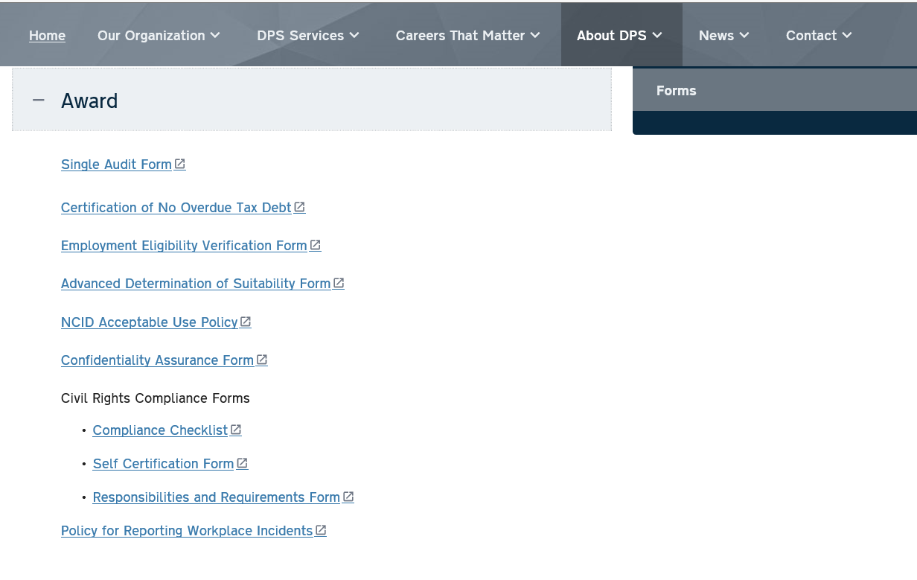
If you did not download Supplemental Forms from DocuSign, go here to get them:
https://www.ncdps.gov/about-dps/boards-and-commissions/governors-crime-commission/grant-forms#award

Slide 10
NOTE! New EEO Certification Procedure
NEW PROCESS – REVIEW IN ITS ENTIRETY
FY2020 Governor’s Crime Commission Grant Award Supplemental
Form: Award Attachment 01 – Equal Employment Opportunity
Plan Certification
If a subrecipient does not wish to use the tool, they should fill out the form and submit it to
EEOPForms@usdoj.gov. Note, however, that the criteria provided for Section B are no longer
correct, and that all recipients of awards of $25,000 or more are required to prepare and submit
an EEOP.
All subrecipients should save a screenshot/copy of their EEOP submission
acknowledgement or a copy of the email sent to USDOJ at the address above. The Project
Director or Authorizing Official should sign and date the screenshot or email copy. This
document should be uploaded for Attachment 1.
Relevant Links
➢ EEOP Reporting Tool/EEO Reporting System Log-in
www.ojp.gov/about/ocr/eeop
➢ EEOP Reporting Tool Job Aid (Instructions on how to complete the online EEO reports
or claim exemption)
https://www.ojp.gov/sites/g/files/xyckuh241/files/media/document/EEOReportTool_JobAid.pdf
➢ EEOP Frequently Asked Questions
https://www.ojp.gov/program/civil-rights/equal-employment-opportunityprogram-
eeop-faqs
NCDPS projects - GCC already has the completed certification for NCDPS and our staff can send it to the project director upon request to upload to your grant in GEMS

Slide 11
No Overdue Taxes
Grant Certification – No Overdue Tax Debts
NONGOVERNMENTAL ENTITIES ONLY
Nonprofits ONLY
Government agencies do NOT need to complete this form

Slide 12
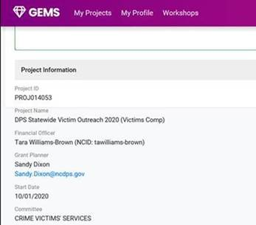
How to find your CVS grant planner…

Slide 13
Questions?
Notes:
to Allen J Wimmer (privately): 1:44 PM
Can I pull up my PPT now?
from Andrea to everyone: 1:56 PM
Hello. I am having issues with sound can someone say somethign please?
from Andrea to everyone: 1:57 PM
Thank you. It works now.
from Laura Jeffords to everyone: 2:01 PM
Will you also be talking abotu VAWA funded grants today?
from krlombri to everyone: 2:06 PM
Laura, if you have VAWA questions regardning to your project that opened on 10/1/20, you can bring it up here.
from SConley (privately): 2:07 PM
Could you forward the screen?
from SConley (privately): 2:08 PM
Oh sorry I see it's all on the same one. Great that you got it all in one place.
from Laura Jeffords to everyone: 2:10 PM
It still says "awaiting receipt of award". I don't think we've received info about what is holding it up or an estimated timeline. I inquired a few weeks ago, and was told "you'll be notified".
from krlombri to everyone: 2:11 PM
Laura, please e-mail me your Project Number. Karen.Lombri@ncdps.gov
from dbarber-whitaker to everyone: 2:13 PM
Projects that have been reviewed by the GCC planning staff and deemed complete (all requested modifications made) are entered into the Awaiting Recipient grant status. Your project can sit in that status for varying amounts of time (e.g., while other projects are being reviewed or, in this case, while we were waiting for the federal grant system to upload NC's balance)
from Laura Jeffords to everyone: 2:13 PM
Thanks, Karen. I e-mailed you.
from Tim Tilley (privately): 2:16 PM
Will you be sharig the power point?
from Shannon Knapp to everyone: 2:16 PM
The presentation cut out during…we don’t know what slides we missed? Is this recorded and will it be sent?
from Kristy Graf to everyone: 2:17 PM
I was cut out too and can't hear anything
from Laura Jeffords to everyone: 2:17 PM
So if we sent our forms back 30 days ago, when should we expect to be open?
from ccottrell (privately): 2:17 PM
Was it stated when these docusign documents will be coming out? Our Authorizing Official will change in January.
from Nicki Livingston (privately): 2:18 PM
48 hour turnaround with Admin if all supplmental forms are signed and submitted in GEMS
from Shannon Knapp to everyone: 2:18 PM
We have tried to update authorizing official in GEMS, have accepted the new authoriazing official & deactivated the old one, but it's not showing in GEMS. ??
from Allen J Wimmer to everyone: 2:18 PM
Yes the meeting is recorded and will be available via the GCC Website.
from Tim Tilley (privately): 2:18 PM
We continue to have issues with ASAP.gov and completing requested information. Is ASAP.fiscal.treasury.gov connected in anyway to the Just Grant system?
from Shannon Knapp to everyone: 2:18 PM
Great, thanks. Allen
from Valerie True to everyone: 2:19 PM
Our officials will change in January. Should we wait for the officials to change and have those officials sign?
from ccottrell to everyone: 2:20 PM
I have the same question as Valerie.
from Shannon Knapp to everyone: 2:24 PM
OK got it thanks
from Deborah Day to everyone: 2:25 PM
When you say "grant planner", does that mean the GCC staff who processed our application or the staff who will be managing the grant?
from Shannon Knapp to everyone: 2:25 PM
I did step by step, but may have missed something. Thanks!
from Shannon Knapp to everyone: 2:26 PM
We're not getting emails back fromour grant planner
from Shannon Knapp to everyone: 2:26 PM
OK, Sandy! Will do!
from Allen J Wimmer to everyone: 2:26 PM
sandy.dixon@ncdps.gov
from krlombri to everyone: 2:26 PM
Sandy.Dixon@ncdps.gov
from Valerie True to everyone: 2:27 PM
Thank you!
from Shannon Knapp to everyone: 2:27 PM
Thank you
from dbarber-whitaker to everyone: 2:28 PM
Thank you everyone!!
from Andrea to everyone: 2:28 PM
Thank for this session! happy holidays everyone!
from Haley Harris to everyone: 2:28 PM
I had to come in late. Was this webinar recorded?
from Allen J Wimmer to everyone: 2:29 PM
Haley yes this was recorded.
from Haley Harris to everyone: 2:29 PM
Great, thank you!

