Slide 1
Work Release expansion
State Reentry Council Collaborative
November 12, 2024

Slide 2
Background
Purpose and overview
Basic processes
Employer responsibilities
Facility responsibilities
Incarcerated individual responsibilities
Division-wide support

Slide 3
Benefits of Work Release
Job skill development
Employer relationships
Self-efficacy and self-image
Financial
State
Community
Individual
Employer

Slide 4
Current Status
100+ active Work Release employers
27 active sites
$12-15/hour
Food Service, Manufacturing, Customer Service
95% self-reported Second Chance Employers
750 assigned

Slide 5
Areas for Improvement
Employer network
Streamlining standard processes
Documentation and monitoring
Transportation

Slide 6
Employment Programs Team
Regional distribution
Process review and improvement
Enhanced information sharing
Centralized required processes
Employer outreach and vetting
Transportation assistance

Slide 7
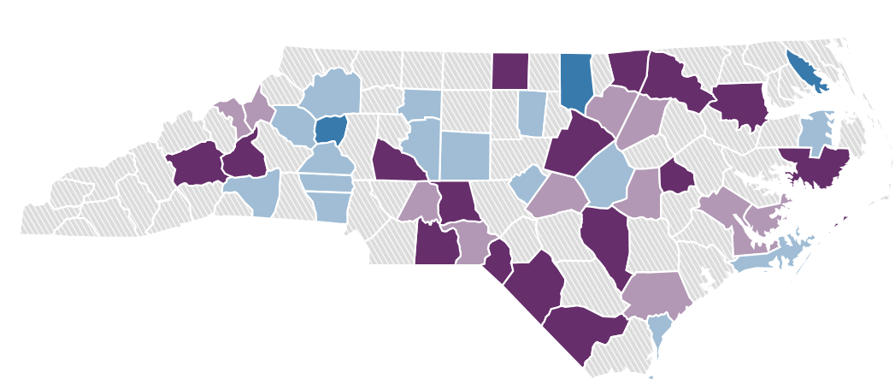
Strategy and Planning

Slide 8
Getting Involved
Share open positions
Share employer networks
Attend future Employment Programs events

Slide 9
Contact
Charles Mautz, charles.mautz@dac.nc.gov
NeoGov
LinkedIn

