Slide 1

RREPS
Recidivism Reduction Educational Program Services

Slide 2
Mission & Vision
RREPS (Recidivism Reduction Educational Programs Services, Inc.) is a non-profit organization focused on reducing recidivism and reforming the criminal justice system. We work to address systemic and unconscious bias for incarcerated and formerly incarcerated people through both policy advocacy and community-based programs. Our efforts include; incarceration prevention, reentry services and criminal justice reform. We accomplish these objectives through our three arms: We Keep Us Safe (Organizing Arm), People Power (Policy Arm), and Recidivism Reduction (Reentry Arm)

Slide 3

The problem
Lack of mobility & connectivity to Reentry Resources.

Slide 4
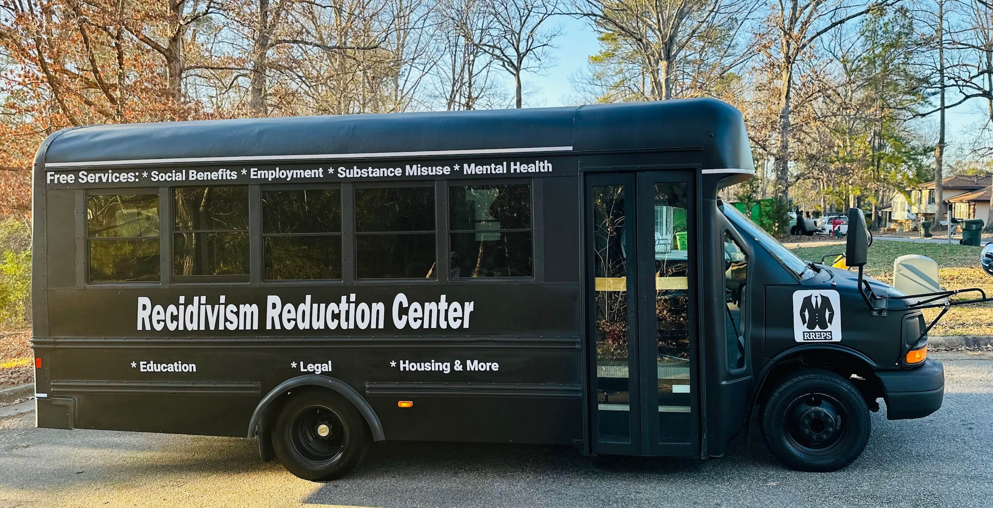
The Solution

Slide 5
How it works
Our Mobile Recidivism Reduction Center launched on January 17, 2025 is dedicated to providing critical reentry support directly to justice-involved and justice-impacted individuals and communities, meeting them literally where they are. Designed to serve underserved communities across North Carolina, this innovative mobile center brings essential resources to individuals who need them most, empowering them with the tools, skills, and support to successfully reintegrate into society.
Our services focus on addressing the root causes of criminogenic thinking and behavior, while also providing support for reentry challenges, and helping individuals build stable and productive lives. Inside our Mobile Recidivism Reduction Center, we offer a range of services tailored to reduce recidivism and promote long-term success. Our Mobile Recidivism Reduction Center covers all 100 counties throughout the state of North Carolina. During our pilot phase our hours of operation are Tuesday & Wednesday - Friday & Saturday from 9am-5pm.

Slide 6
How it works
Regional Implementation Strategy
We will employ a divided regional implementation strategy. The state will be organized into four regions – Central, South Central, Eastern, and Western – each with dedicated Mobile Recidivism Reduction teams and tailored approaches.
Central Region: Encompassing counties in and around the state's capital and heartland (including Wake County's ongoing operations), the Central team will build on our pilot's success.
South Central Region: Covering the south-central part of the state (including major cities like Charlotte and Fayetteville and their neighboring counties)
Eastern Region: This region includes the eastern and coastal counties, many of which are rural and have historically lacked reentry resources.
Western Region: The Western region spans the Appalachian mountain and foothills counties, where services are often spread thin.

Slide 7
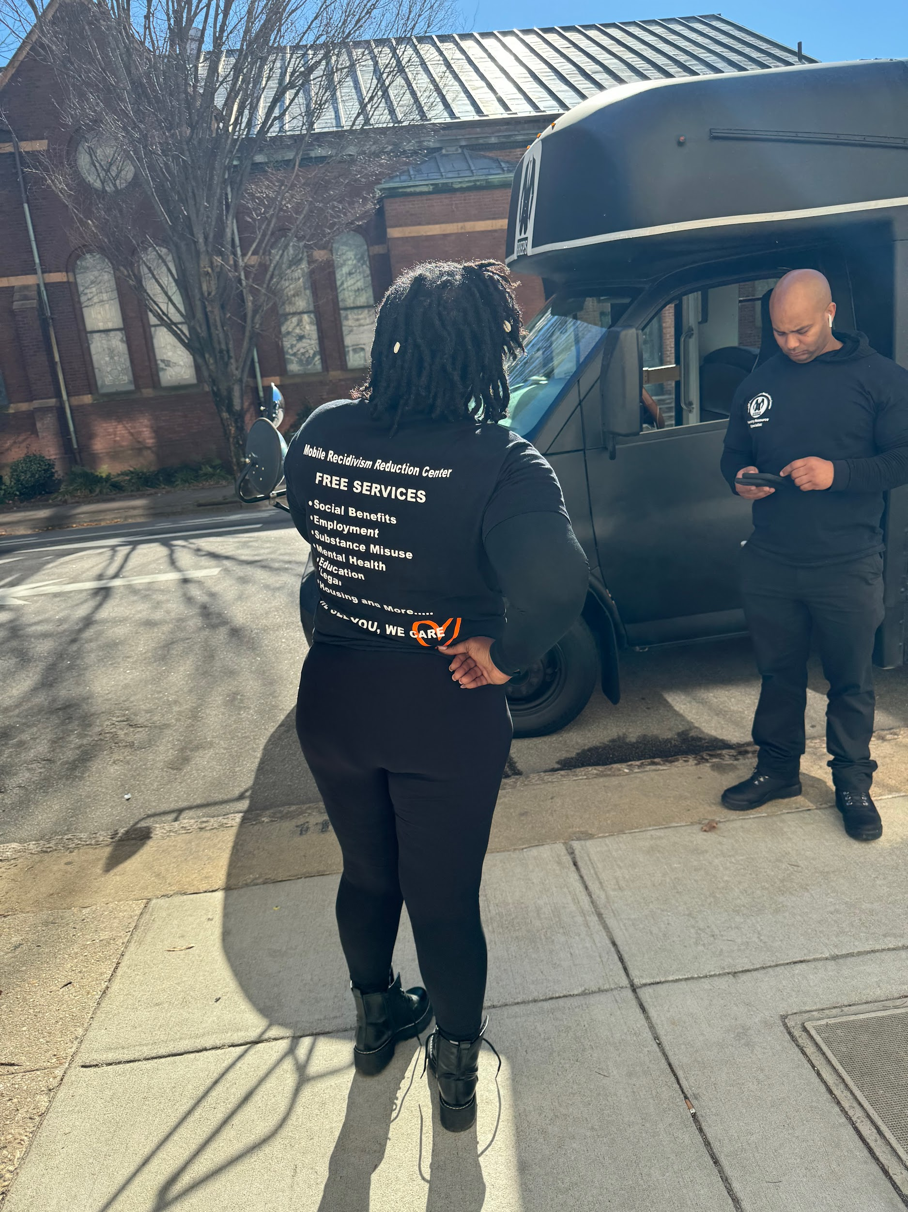
How it works
Our Mobile Recidivism Reduction Center covers all 100 counties throughout the state of North Carolina. Below is a list of services offered directly on our center:
- Social Benefits Assistance
- Employment Assistance
- Education and Skill Development
- Mental Health Services Assistance
- Substance Misuse Treatment Assistance
- Housing Assistance
- Legal Support
- Family and Community Support
- Digital Literacy & Digital Equity Assistance
- Cognitive Behavioral Therapy (CBT) Programming Assistance
- Life Skills Training
- Inclement Weather Assistance
- Hygiene Kits Distribution
- Harm Reduction Supplies Distribution

Slide 8
Takeaways & How its going
Although newly launched, the MRRC's initial operations demonstrate the high demand for services and the program's ability to deliver results.
The MRRC officially began serving clients on January 17, 2025. In the first 26 days of operation (less than one month), the program had already engaged 811 justice-involved individuals in Wake County
Each of these 811 individuals received one or more of the MRRC's services – whether it was help with a benefits application, a referral to a treatment program, or immediate crisis intervention and basic needs support.
This rapid enrollment far exceeded initial projections and highlights the acute need in the community
In the first month we have serviced over 1,000 individual in Wake County alone.

Slide 9
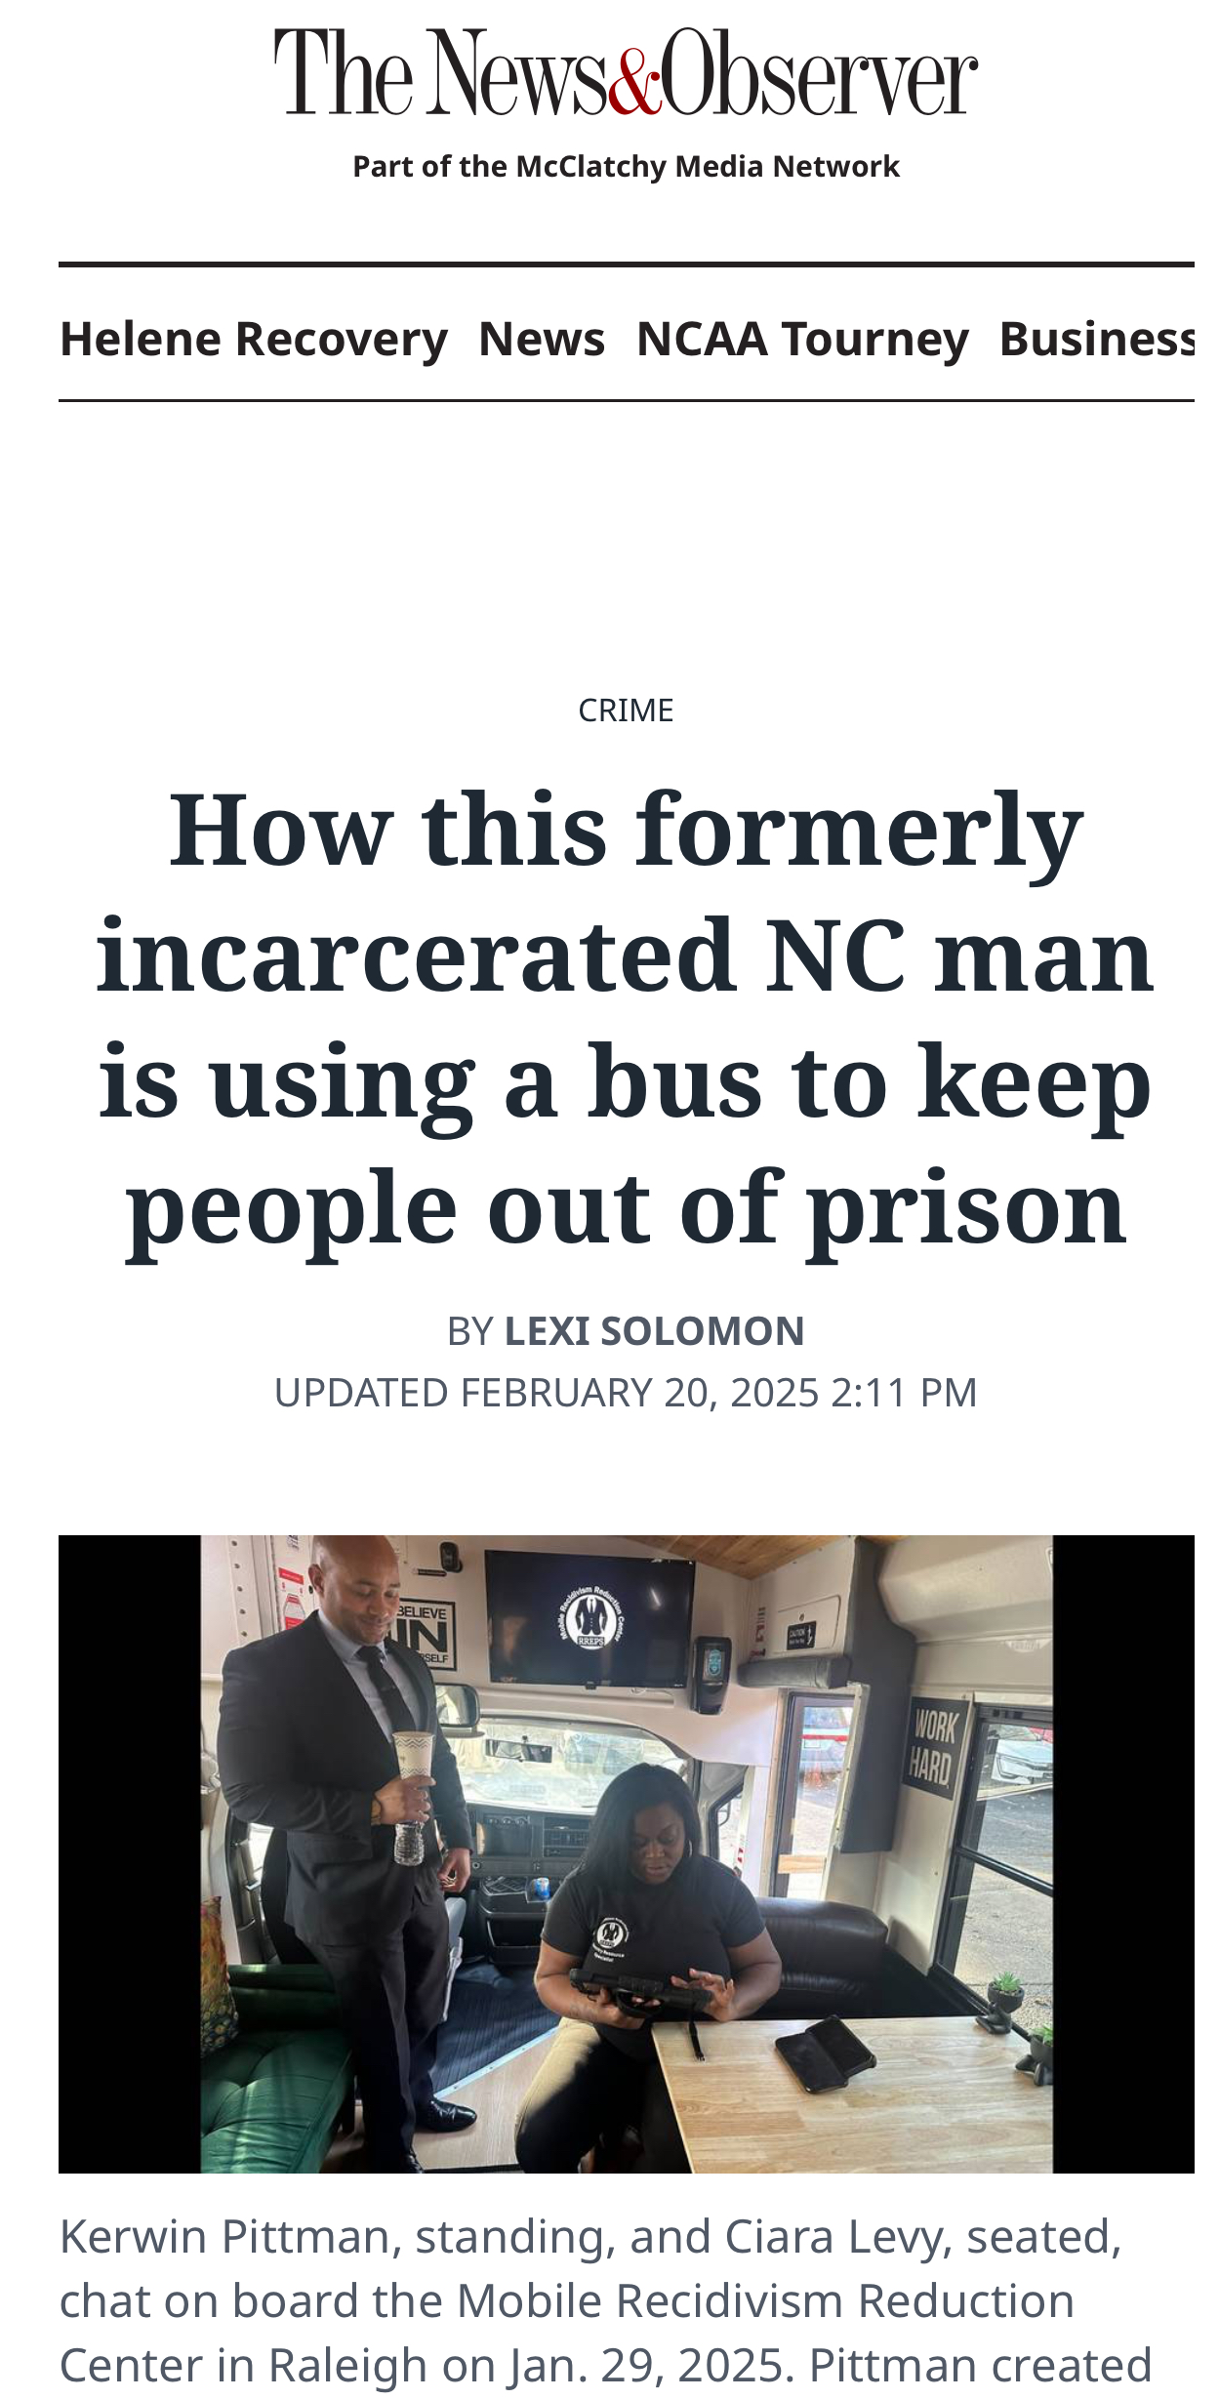
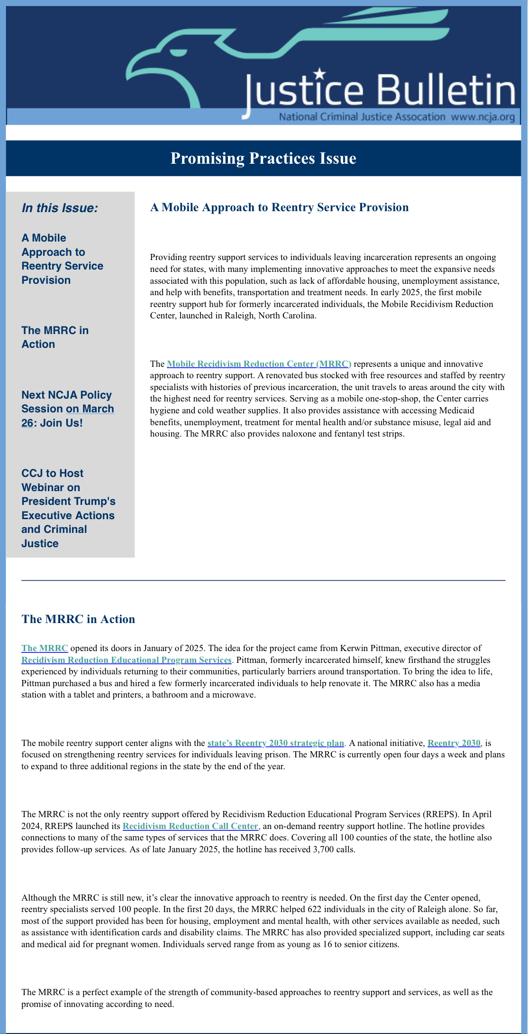
How its going

Slide 10
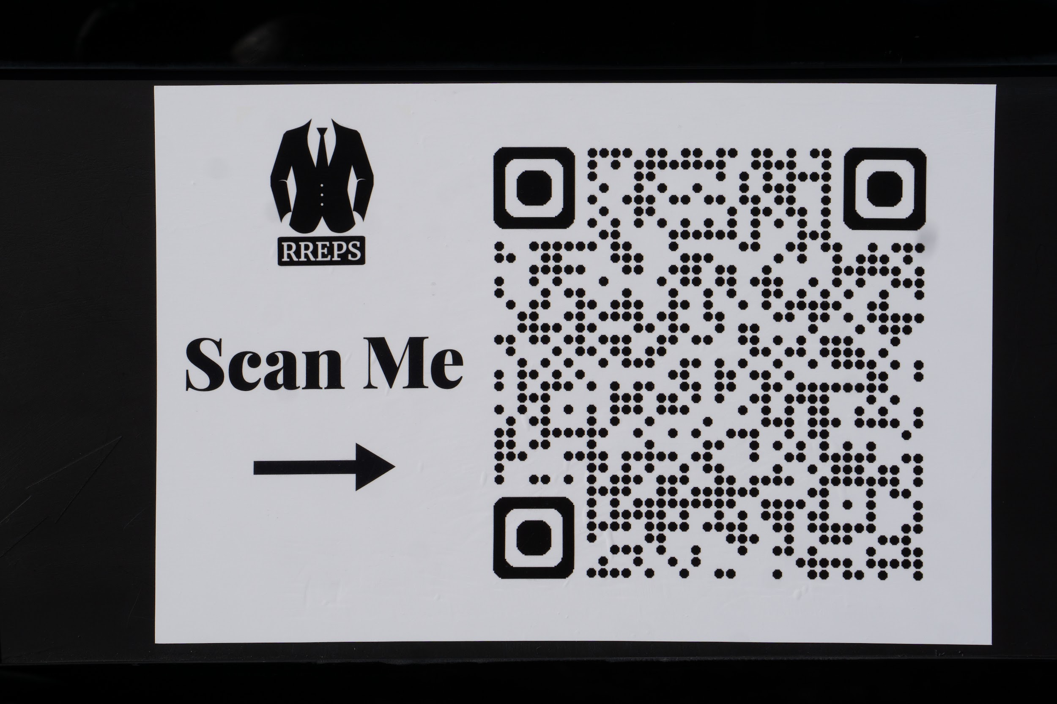
Mobile Recidivism Reduction Center Information
Q&A

Slide 11

Contact Information:
Kerwin Pittman
Executive Director
Email: Kerwin@rreps.net
(919) 520-1194
www.rreps.net

