Slide 1


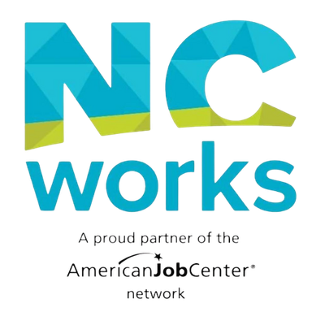


WORKFORCE DEVELOPMENT AND LOCAL REENTRY COUNCILS
BUILDING EMPLOYMENT PATHWAYS FOR RETURNING CITIZENS IN THE PIEDMONT TRIAD

Slide 2

WHY WORKFORCE MATTERS IN REENTRY
WORKFORCE DEVELOPMENT CONTRIBUTES:
  Career services
  Employer engagement
  Job placement
  Training opportunities
  Second Chance Hiring initiatives
This naturally aligns with the mission of Local Reentry Councils

Slide 3
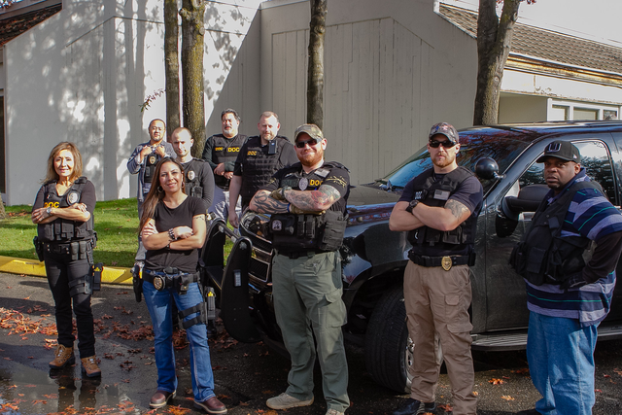



THE PARTNERSHIP MODEL
LRC PARTNERS
WORKFORCE DEVELOPMENT
SUCCESSFUL REENTRY OUTCOMES
  CORRECTIONS
  HOUSING
  BEHAVIORAL HEALTH
  COMMUNITY SERVICES
  NCWORKS
  TRAINING
  EMPLOYERS
  CAREER SERVICES
  STABLE HOUSING
  EMPLOYMENT OPPORTUNITIES
  EDUCATIONAL ACCESS
  INCREASED CONFIDENCE

Slide 4

W
FORSYTH COUNTY
AN ESTABLISHED PARTNERSHIP
FORSYTH COUNTY LOCAL REENTRY COUNCIL
  Well-established Local Reentry Council
  NCWorks co-located with the council
  Strong partnership between NCWorks leadership and LRC staff
  Joint program development
  Coordinated referrals
  Shared commitment to employment outcomes

Slide 5

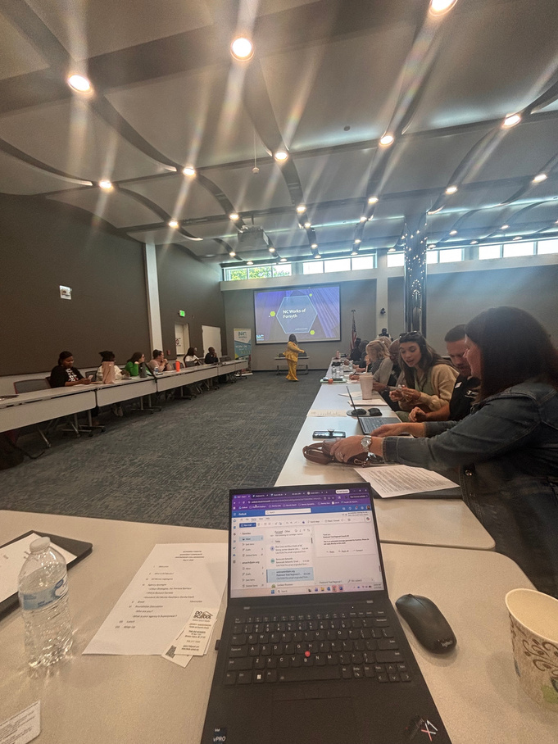
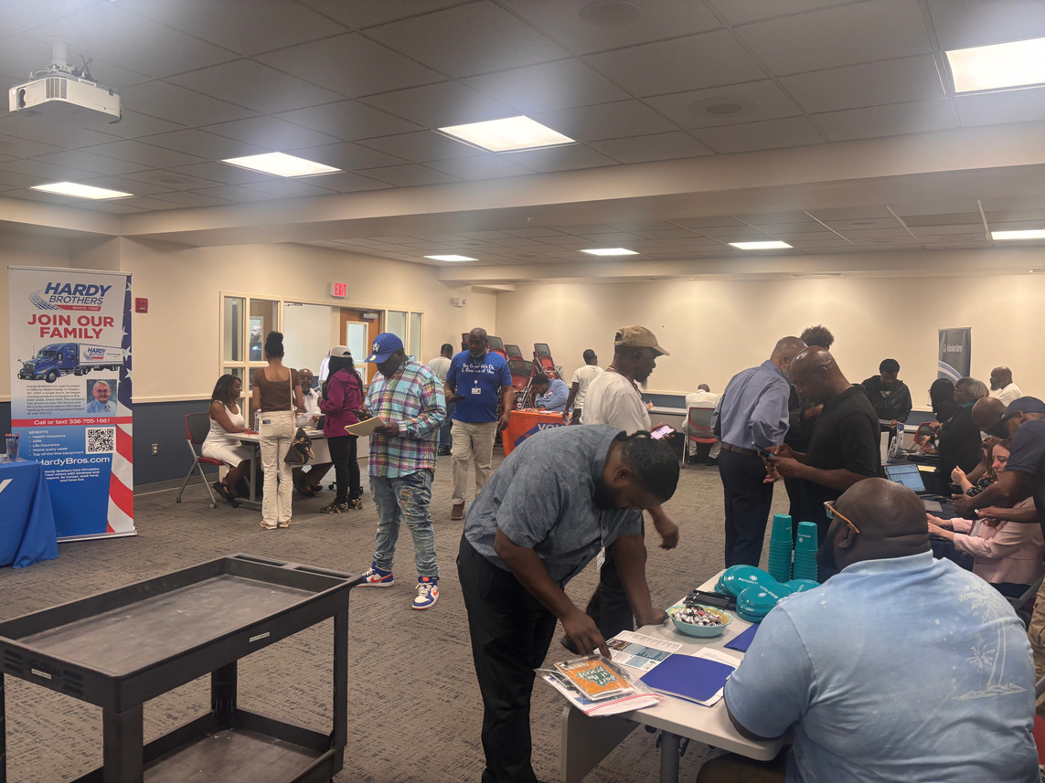
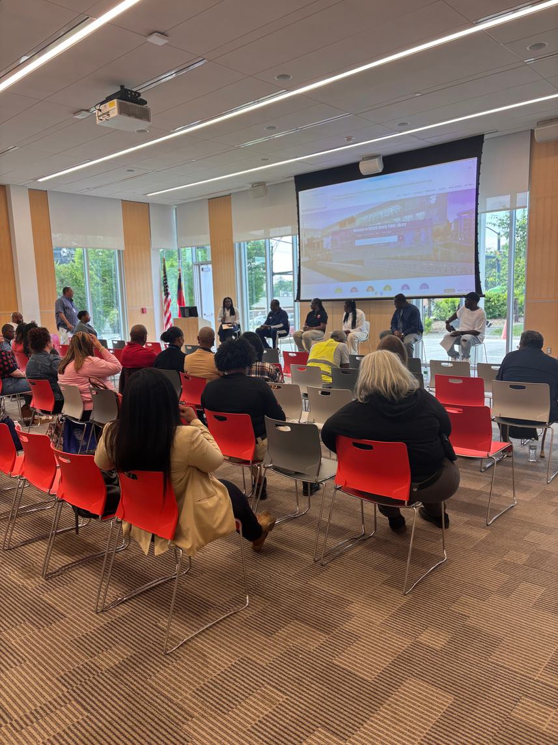
W
PROGRAMING IN ACTION
EXAMPLES OF COLLABORATIVE PROGRAMMING
HIRING INITIATIVES
WORKFORCE SERVICES
WORKSHOPS
  RESUME DEVELOPMENT
  INTERVIEW PREPARATION
  JOB SEARCH STRATEGIES
  WORKPLACE SUCCESS SKILLS
  SECOND CHANCE HIRING EVENTS
  EMPLOYER ENGAGEMENT ACTIVITIES
  FAIR CHANCE HIRING EDUCATION
  CAREER COUNSELING
  TRAINING OPPORTUNITIES
  SUPPORTIVE SERVICES

Slide 6
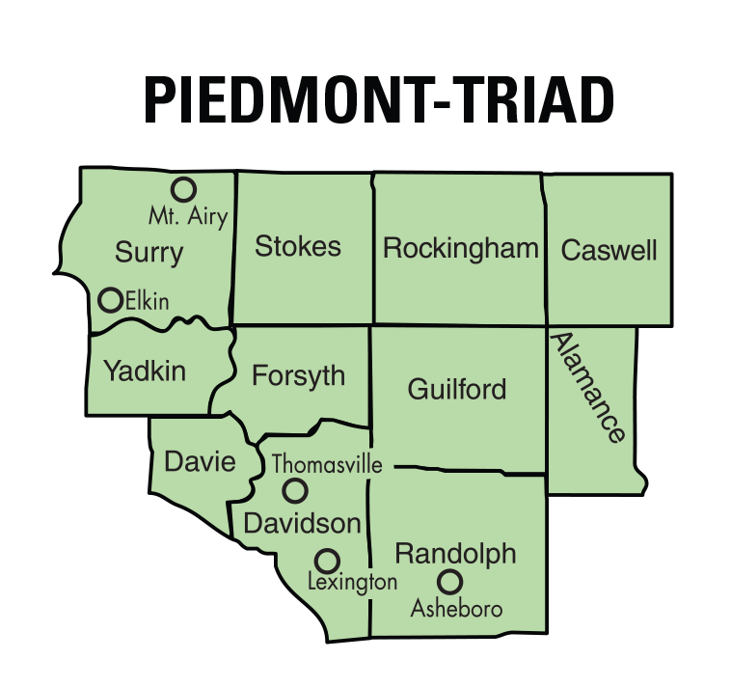

EXPANDING THE MODEL
SUPPORTING EMERGING COUNCILS
We're not only supporting established partnerships—we're helping build new ones.
EMERGING COUNCILS
Role of NCWorks Career Center Managers:
  Local champions
  Stakeholder conveners
  Community connectors
Role of Regional Reentry Coordinator:
  Technical assistance
  DAC framework guidance
  Capacity building

Slide 7

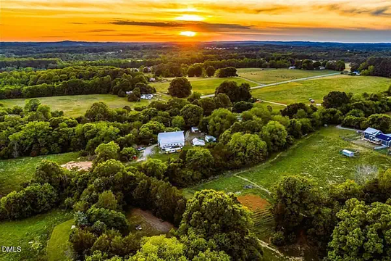
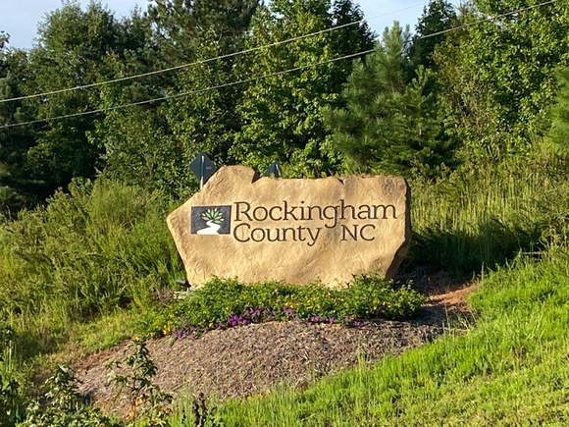
W
EMERGING COUNCIL PROGRESS
SURRY COUNTY
RANDOLPH COUNTY
ROCKINGHAM/
CASWELL COUNTIES
  STAKEHOLDER MEETINGS UNDERWAY
  WORKFORCE DEVELOPMENT ENGAGED IN PLANNING
  COMMUNITY NEEDS BEING IDENTIFIED
  COUNCIL FORMATION ACTIVITIES IN PROGRESS
  COMMUNITY PARTNERS BEING RECRUITED
  WORKFORCE PARTICIPATING IN PLANNING EFFORTS
  PARTNER RECRUITMENT UNDERWAY
  COMMUNITY COLLABORATION GROWING
  BUILDING A FOUNDATION FOR LONG-TERM SUCCESS

Slide 8
LESSONS LEARNED
WHAT MAKES THESE PARTNERSHIPS SUCCESSFUL?
✓ Dedicated local champions
✓ Workforce represented at the table
✓ Strong employer engagement
✓ Consistent partner communication
✓ Focus on employment as a reentry strategy

Slide 9
CLOSING / CALL TO ACTION
KEY TAKEAWAYS
Workforce Development is uniquely positioned to support Local Reentry Councils because we bring:
Employers
Training resources
Career services
Community convening power
From Forsyth County's mature partnership to emerging councils in Surry, Randolph, and Rockingham/Caswell, these collaborations are helping create stronger pathways to employment and successful reentry across our region.

