Slide 1

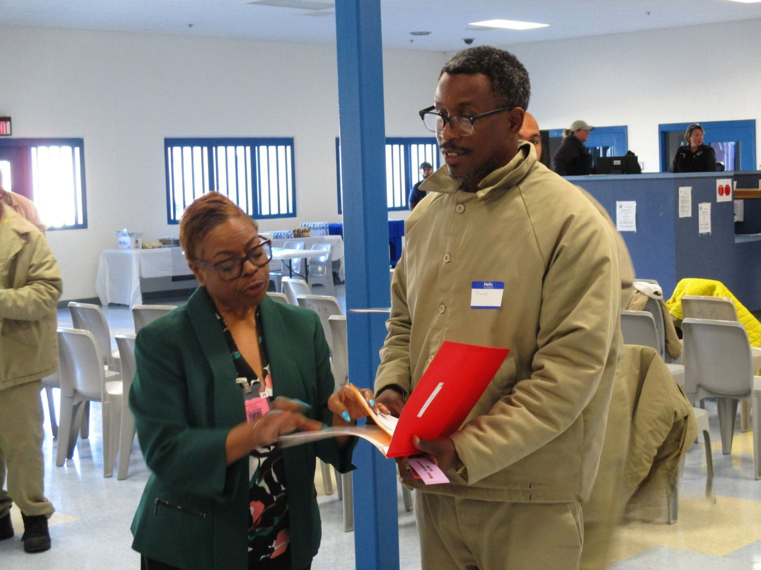
NC PROWD:
REENTRY 2030 IN ACTION
Presenter
NATALIE MABON
REGIONAL REENTRY PROJECT MANAGER

Slide 2
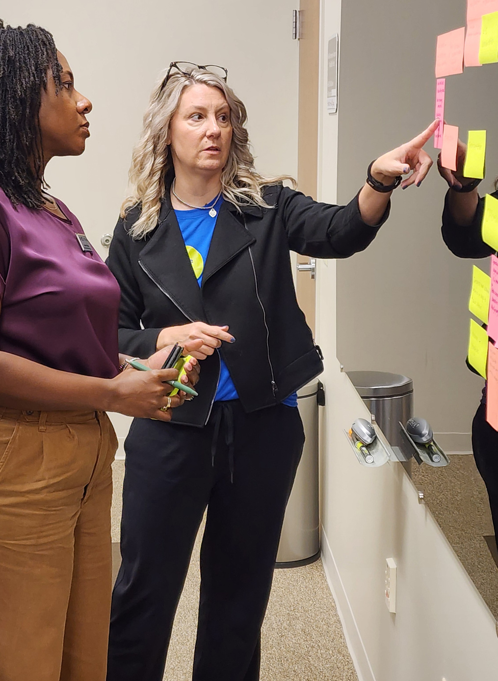

ABOUT US
In 2022, the US Department of Justice (DOJ) and the US Department of Labor (DOL) partnered and launched the PROWD grant.
North Carolina Department of Commerce was awarded nearly $10 million to partner with the Capital Area, Kerr-Tar, and Durham Workforce Development Boards to provide seamless coordinated reentry services.
The Goal:
Align job training and skills development services provided to federally incarcerated individuals to the labor market needs of the communities where they will live.

Slide 3
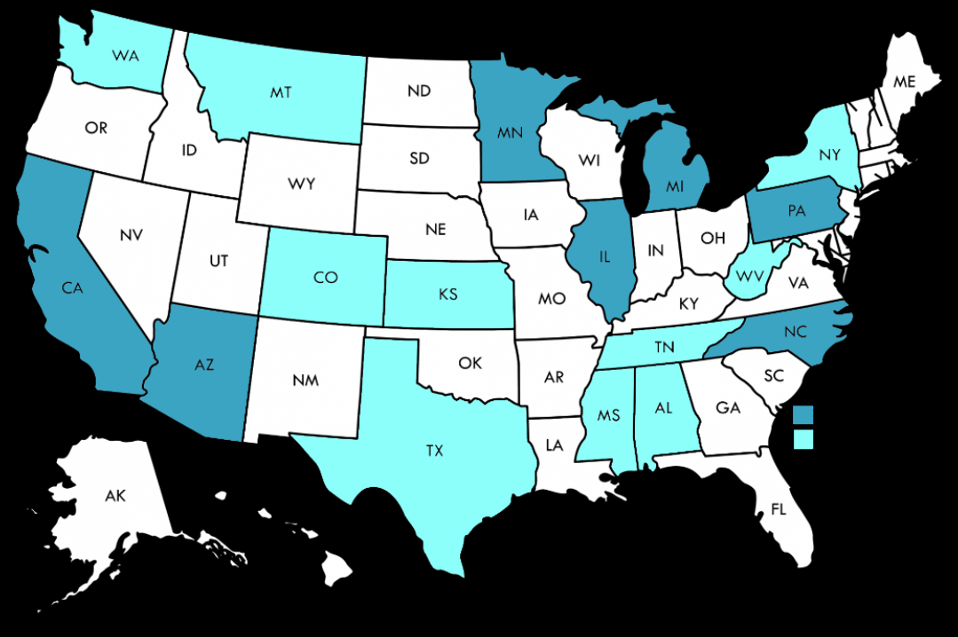
PROWD GRANT RECIPIENTS
North Carolina is one of seven pioneering states awarded funding in 2022
In 2023 the initiative had grown to include programs in 17 states
02
04
NORTH CAROLINA REMAINS THE NATIONAL SUCCESS MODEL!

Slide 4

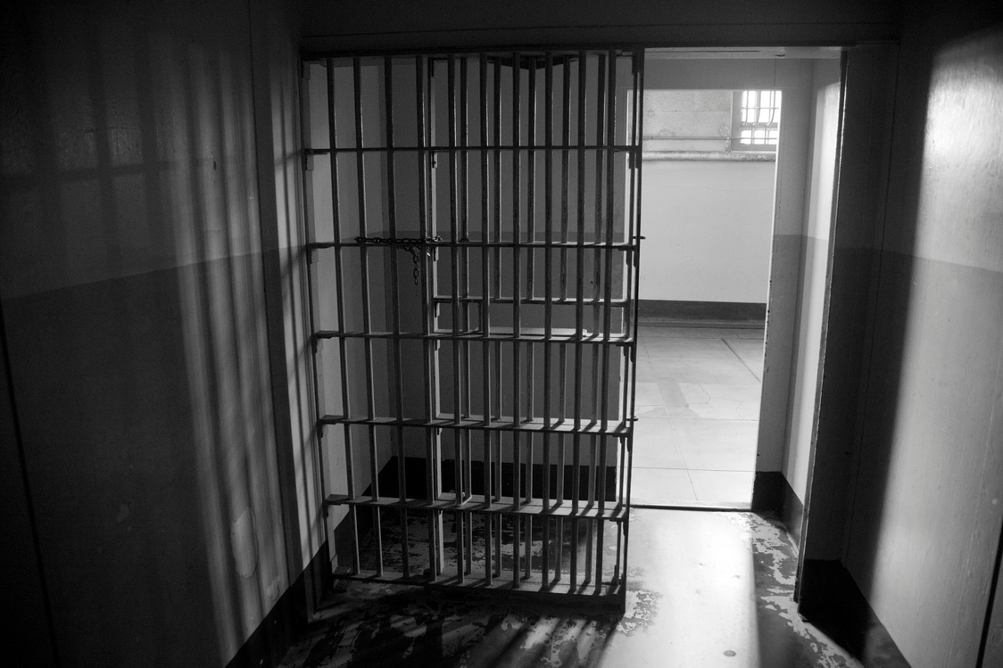


3 STAGE
REENTRY MODEL
Incarceration
Transition
Released
Individuals can volunteer to participate in NC PROWD activities while still incarcerated.
They may be temporarily residing in a Residential Reentry Centers (RRC) or reporting to the RRC from home confinement.
The participant is living independently back in their community.

Slide 5

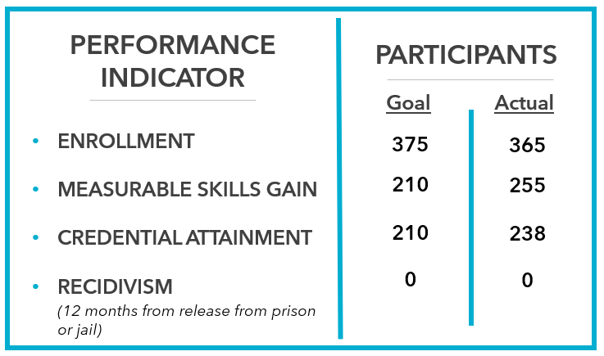
PERFORMANCE GOALS

Slide 6
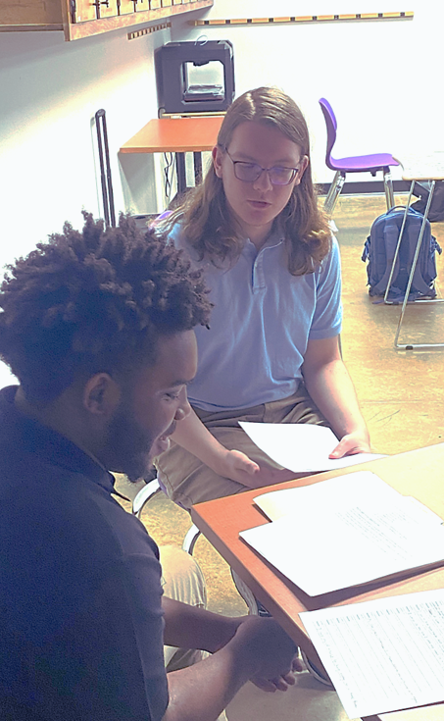
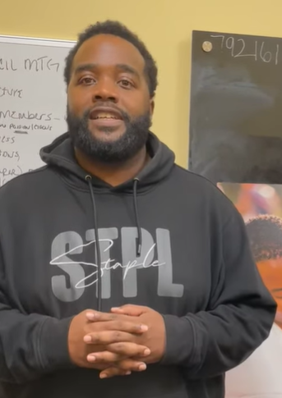
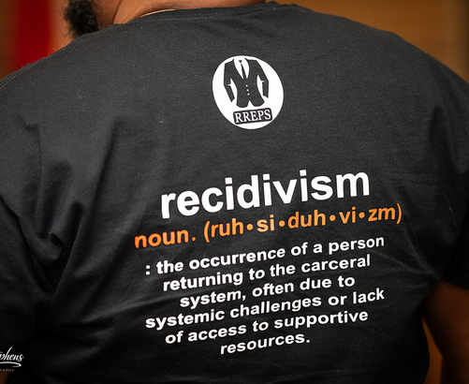
NC PROWD SERVICES
WHO WE SERVE
Age 18+
Incarcerated in a Federal Institution
Verified Selective Service
HOW WE SERVE
Case Management
Skills Building
Job Training
Education
Career Advising
Supportive Services
NCWorks Access
PROWD ensures that program participants have the skills required to obtain employment and successful independence
as well have access to supportive services to help them retain it.

Slide 7
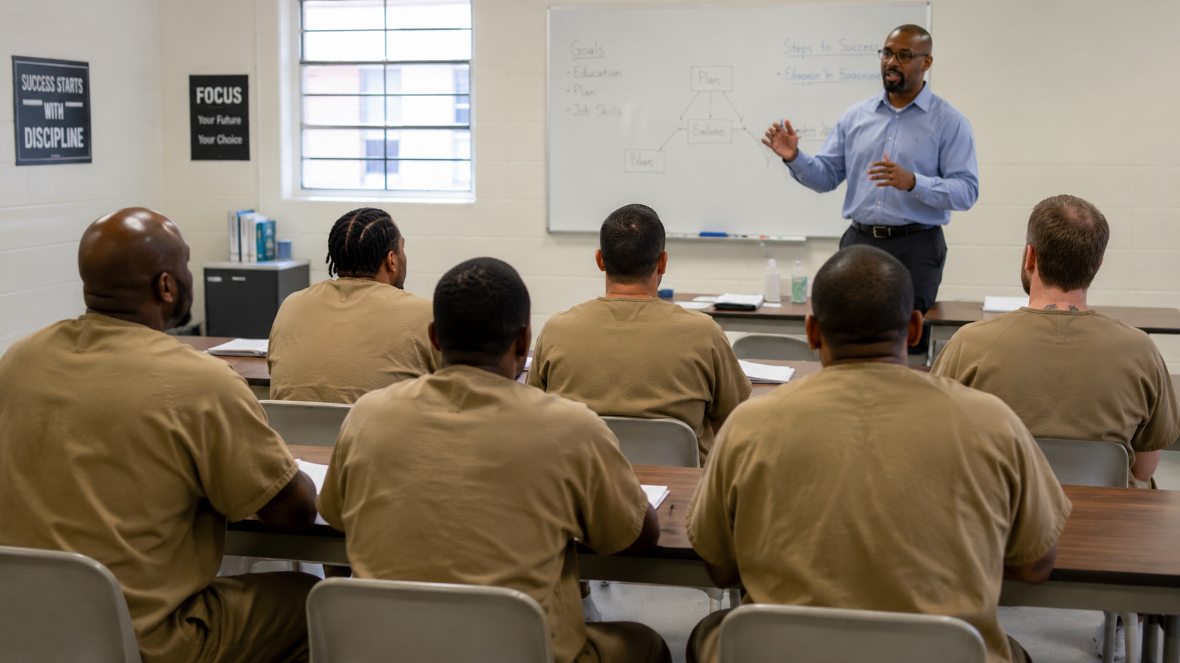

PRE-RELEASE
POST-RELEASE
Services
Services
  Needs assessments
  Individual development plans
  Comprehensive case management
  Career exploration and planning
  Job preparation
  Industry-recognized certifications
  Community resource allocation
  Systems navigation
  Career mapping
  Industry-recognized certifications
  Employment support
  Comprehensive case management

Slide 8
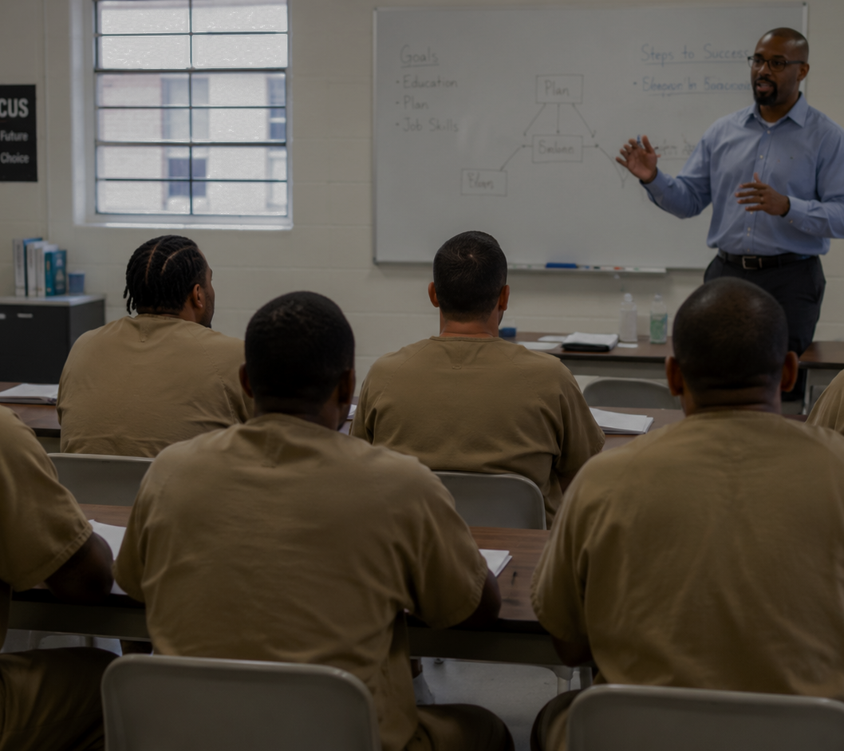
MOST POPULAR CREDENTIALS & TRAININGS
Forklift Certification
CDL
OSHA-10
ServSafe Handler
ServSafe Manager
Customer Service
HVAC
Electrical
Building Maintenance
Entrepreneurship
04
AI image

Slide 9

PARTNERSHIPS MATTER!
Strong. Relevant. Transformative.
Solid partners ensure that support systems are not only comprehensive but deeply connected to real community needs. Having a shared purpose and coordinated action increases the likelihood that individuals can access the right resources at the right time.
Partnerships have major impacts on:
  Training Programs
  Service Delivery
  Employment
  Local Reentry Councils
  “Reentry 2030"
Purposeful partnerships foster collaboration that build programs AND stronger systems of support.

Slide 10
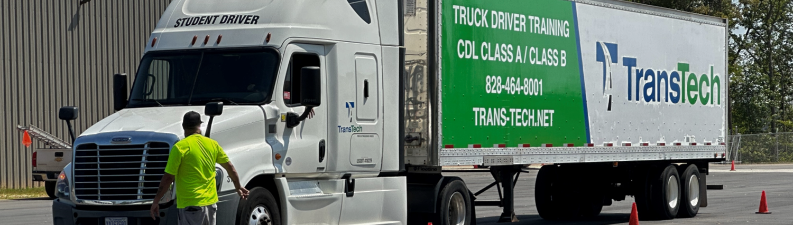
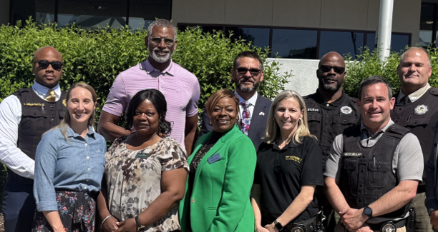
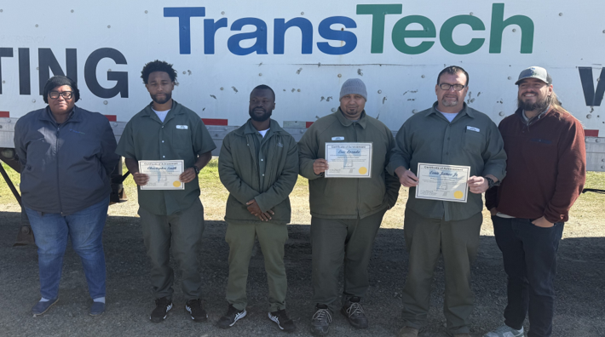
Partnership in Action
NC PROWD CDL TRAINING
The State’s First FCI Butner CDL Program
Federal Bureau of Prisons
FCI Butner Education Department
TransTech CDL Training School
NC Department of Transportation
Roxboro Driver’s License Office

Slide 11
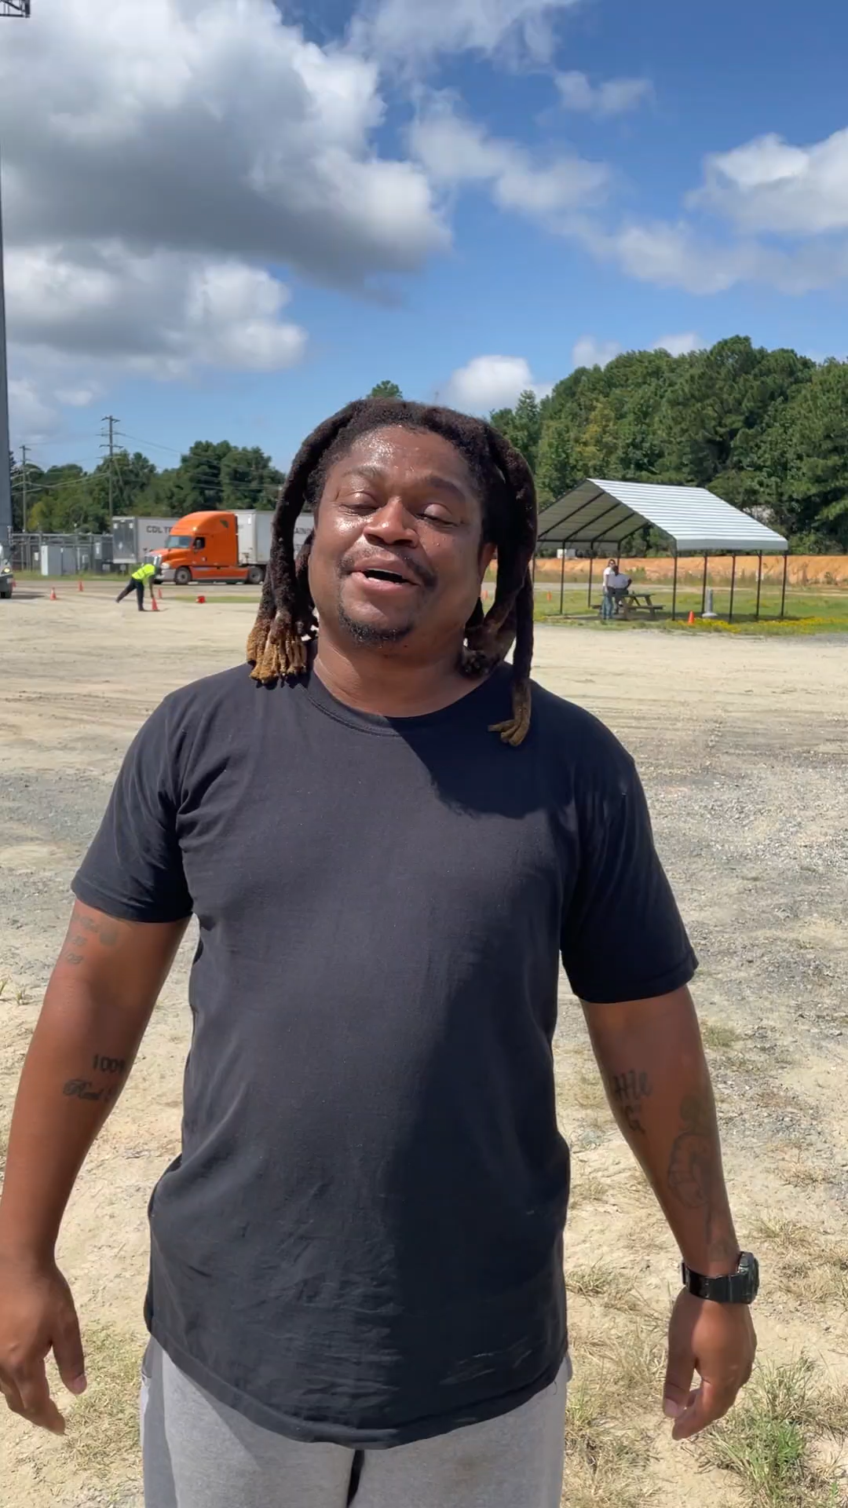
CLIENT SUCCESS:
G. BRANTLEY
After five years of incarceration,
Mr. Brantley took advantage of PROWD’s resources and CDL training in order to change everything about his future!

Slide 12



IMPLEMENTATION TEAM
Pat E. Sturdivant
Russell Ingram
Lou Grillo
Executive Director
Board Director
Executive Director
Natalie Mabon
Michael London
Sharon Thomas
Regional Program Manager
Local Program Manager
Local Program Manager
Katie El Tannir
Local Program Manager

Slide 13

THANK YOU
For more information contact: Natalie Mabon
Natalie.mabon@wake.gov (919) 526-0210

